Slide 1


Chapter 6 The Link Layer
and LANs
A note on the use of these Powerpoint slides:
We’re making these slides freely available to all (faculty, students, readers). They’re in PowerPoint form so you see the animations; and can add, modify, and delete slides (including this one) and slide content to suit your needs. They obviously represent a lot of work on our part. In return for use, we only ask the following:
Computer Networking: A Top Down Approach
If you use these slides (e.g., in a class) that you mention their source (after all, we’d like people to use our book!)
If you post any slides on a www site, that you note that they are adapted from (or perhaps identical to) our slides, and note our copyright of this material.
Thanks and enjoy! JFK/KWR
All material copyright 1996-2016
J.F Kurose and K.W. Ross, All Rights Reserved
7th edition Jim Kurose, Keith Ross Pearson/Addison Wesley April 2016

Slide 2
Link layer, LANs: outline
6.1 introduction, services
6.2 error detection, correction
6.3 multiple access protocols
6.4 LANs
Ethernet
IP and Link/MAC addresses
IPv4 and ARP
IPv6 addressing modes and NDP

Slide 3

















Link layer: introduction
terminology:
hosts and routers: nodes
communication channels that connect adjacent nodes along communication path: links
point to point: - direct
wired – twisted pair, coax, fiber
wireless – cellular, satellite, microwave
broadcast/shared: - multipoint
wired/wireless – LANs
layer-2 packet: frame, encapsulates datagram
data-link layer is responsible for
transferring datagram (message) from a node
to another, physically adjacent, node, over a link

Slide 4
Link layer: context
datagram encapsulated in a link-layer frame
different types of links with corresponding link protocols
e.g., Ethernet on first link, frame relay on intermediate links, Wifi LAN on last link
frame transferred by link protocol for a specific link
each link protocol provides different services
e.g., may or may not provide reliable data transport over link
network path (Source to destination) – routing algorithm
transportation analogy:
trip from Irvine to SF via LA
shuttle: Irvine to LAX
plane: LAX to SFO
Bart: SFO to downtown SF
traveler = datagram
transport segment (e.g., Irvine to LA) = communication link
transportation mode (e.g. shuttle) segment dependent = link layer protocol
different services for segments, e.g., plane vs taxi vs Bart
food, bathroom…..
travel plan (Irvine – LAX – SFO- SF) = routing algorithm

Slide 5
Link layer: services
framing, link access:
encapsulate datagram into frame -> adding header, trailer
E.g., addresses in header and error correction in trailer
access mechanism – decision when to transmit on link, crucial if shared medium
flow control:
pacing data transmission between sending and receiving nodes on a link
half-duplex and full-duplex
with half duplex, nodes at both ends of link can transmit, but not at same time
full duplex allows transmission in both directions simultaneously
reliable delivery between adjacent nodes
error detection
error recovery - links have different error rates
seldom used on low bit-error links (fiber, coax, ……)
generally needed on wireless links due to high error rates

Slide 6
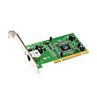
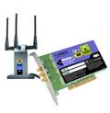

Where is the link layer implemented?
in each and every networked device
link-layer is combination of:
software (implemented in OS) and hardware and firmware (implemented on card/chip)
types of hardware:
Net Interface Card (NIC): Ethernet card, Wifi card…
Chipsets: Ethernet, Bluetooth..
NIC/chipset implements physical layer and access part of link layer
NIC attaches into device’s system bus
chipset part of motherboard
application
transport
network
link
cpu
memory
link
physical
host
bus
(e.g., PCI)
link
controller
physical
transmission
network interface
card

Slide 7
Adaptors communicating
datagram
datagram
controller
controller
sending host
receiving host
datagram
frame
sending side:
encapsulates datagram from network layer in frame
adds error checking bits, flow control, error recovery, etc.
receiving side
flow control, looks for errors, error recovery, etc.
extracts datagram, passes to upper layer at receiving side

Slide 8
Different Types of “Links”
point to point link
nodes/devices are directly connected
link can be wired or wireless
usually don’t use an address to connect to receiving side
broadcast link - multipoint
nodes/devices are connected via a common link that is shared
link can be wired or wireless
devices/nodes sharing a common link/channel of communications constitute a Local Area Network (LAN)
every device has to have an address (referred to as hardware or link layer address) where it can be reached physically on the shared link

Slide 9
Link layer, LANs: outline
6.1 introduction, services
6.2 error detection, correction
6.3 multiple access protocols
6.4 LANs
Ethernet
IP and Link/MAC addresses
IPv4 and ARP
IPv6 addressing modes and NDP

Slide 10
Reliable or unreliable delivery
errors caused by signal attenuation, noise, interference
error detection:
receiver detects presence of errors in received information
can drop frame with errors
relying on higher layers to recover lost data
or
recover from errors
assuming responsibility for data integrity at frame layer
error recovery:
receiver, after detecting errors, can try to recover the data
correction: receiver identifies and corrects the bit error(s)
retransmission: signals sender for retransmission of errored frame

Slide 11
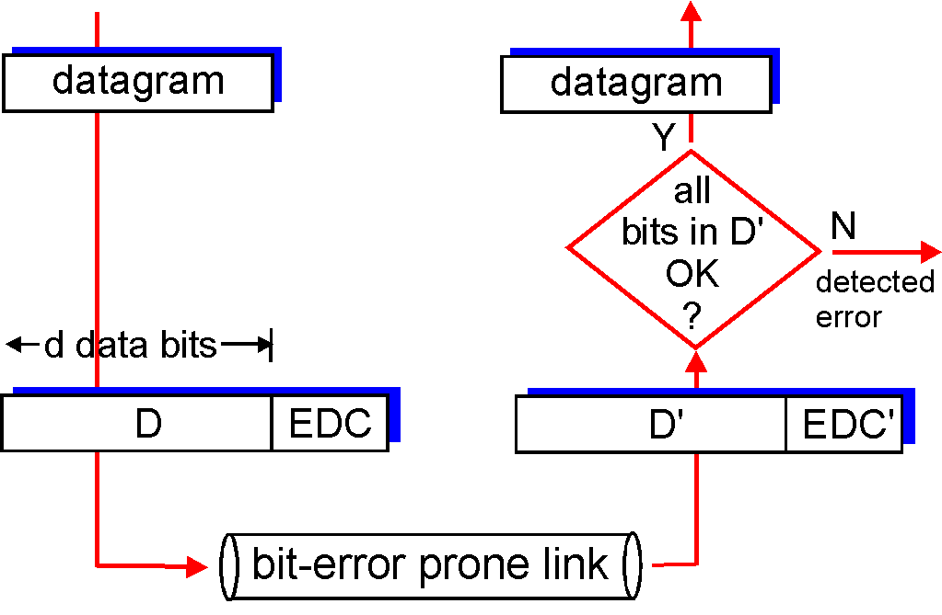
Error detection
EDC = Error Detection/Checking bits (overhead)
D = Data
Error detection not 100% reliable!
EDC may miss some errors, but rarely
larger EDC field yields better detection and maybe some correction
otherwise
D’=D -> ??
What next?

Slide 12
Error recovery
correction - EDC bits can also be used to correct some bit errors (in conjunction with detection)
correction requires larger number of EDC bits than detection - high overhead
used for applications that cannot wait for correct data to be retransmitted
retransmission - when error(s) detected
receiver drops packet and data is retransmitted by sender
waits for sender to timeout (no ACK received) and retransmit, or
receiver sends a negative ACK (NACK) (speeds up process)

Slide 13
Link layer, LANs: outline
6.1 introduction, services
6.2 error detection, correction
6.3 multiple access protocols
6.4 LANs
Ethernet
IP and Link/MAC addresses
IPv4 and ARP
IPv6 addressing modes and NDP

Slide 14


Broadcast/Shared Network Links
a broadcast (shared transmission link (wired or wireless)) constitutes a Local Area Network (LAN)
multiple devices share the same “link”
how do devices determine when to transmit? – access control
shared wire (e.g.,
cabled Ethernet)
shared RF
(e.g., 802.11 WiFi)

Slide 15
Multiple access protocols
single shared link
if two or more simultaneous transmissions on the link → collision
collision → interference at a receiver - jumbled signals
to avoid collisions
need a policy to control multiple simultaneous transmissions
policy grants permission to a node to transmit on the shared medium with no interference from others
multiple access protocol
control algorithm that determines how nodes share a common transmission link
determines when a node can gain access to the link and transmit data avoiding collisions
can be centralised or distributed – pros and cons to each method

Slide 16
An ideal multiple access protocol
given: broadcast link of rate R bps
desired:
1. when one node wants to transmit, it can send at rate R.
2. when M nodes want to transmit, each can send at average rate R/M
3. fully decentralized:
no special node to coordinate transmissions
no synchronization of clocks, slots
possible????
→ trade off between performance and functionality

Slide 17
Multiple access protocols: taxonomy
three broad classes:
channel (link) partitioning
divide link into smaller “pieces” (time slots, frequency, code)
allocate one piece to each node for exclusive use
used for Satellite, broadcast TV, cellular….
random access
may divide link into smaller pieces
no allocations, allow collisions
“detect/recover” from collisions
“taking turns”
allocation but not fixed
nodes take turns, but nodes with more to send can take longer turns
avoids collisions
Notes:
Variations of CSMA use different algorithms to determine when to initiate transmission onto the shared medium. A key distinguishing feature of these algorithms is how aggressive or persistent they are in initiating transmission. A more aggressive algorithm may begin transmission more quickly and utilize a greater percentage of available bandwidth of the medium. This is typically at the expense of increased likelihood of collision with other transmitters.
1-persistent 1-persistent CSMA is an aggressive transmission algorithm. When the transmitting node is ready to transmit, it senses the transmission medium for idle or busy. If idle, then it transmits immediately. If busy, then it senses the transmission medium continuously until it becomes idle, then transmits the message (a frame) unconditionally (i.e. with probability=1). In case of a collision, the sender waits for a random period of time and attempts the same procedure again. 1-persistent CSMA is used in CSMA/CD systems including Ethernet.Non-persistent Non persistent CSMA is a non aggressive transmission algorithm. When the transmitting node is ready to transmit data, it senses the transmission medium for idle or busy. If idle, then it transmits immediately. If busy, then it waits for a random period of time (during which it does not sense the transmission medium) before repeating the whole logic cycle (which started with sensing the transmission medium for idle or busy) again. This approach reduces collision, results in overall higher medium throughput but with a penalty of longer initial delay compared to 1–persistent.P-persistent This is an approach between 1-persistent and non-persistent CSMA access modes.^{[1]} When the transmitting node is ready to transmit data, it senses the transmission medium for idle or busy. If idle, then it transmits immediately. If busy, then it senses the transmission medium continuously until it becomes idle, then transmits with probability p. If the node does not transmit (the probability of this event is 1-p), it waits until the next available time slot. If the transmission medium is not busy, it transmits again with the same probability p. This probabilistic hold-off repeats until the frame is finally transmitted or when the medium is found to become busy again (i.e. some other node has already started transmitting). In the latter case the node repeats the whole logic cycle (which started with sensing the transmission medium for idle or busy) again. p-persistent CSMA is used in CSMA/CA systems including Wi-Fi and other packet radio systems.
When broadcasting over vehicular ad hoc networks, the original 1-persistence and p-persistence strategies often cause the broadcast storm problem.^{[citation needed]} To improve performance, engineers developed three modified techniques: weighted p-persistence, slotted 1-persistence, and slotted p-persistence

Slide 18
Random access protocols
when node has packet to send
transmit
no a priori coordination among nodes
two or more nodes transmit on link at the same time: ➜ “collision” i.e., interference – signal corrupted
random access protocol specifies:
how to detect collisions – e.g., signal comparison, no acknowledgement (ACK), etc.
how to recover from collisions - e.g., via delayed retransmissions

Slide 19
Random access protocol - CSMA
CSMA - carrier sense multiple access
listen before transmit:
if channel sensed idle: transmit entire frame
if channel sensed busy, defer transmission

Slide 20
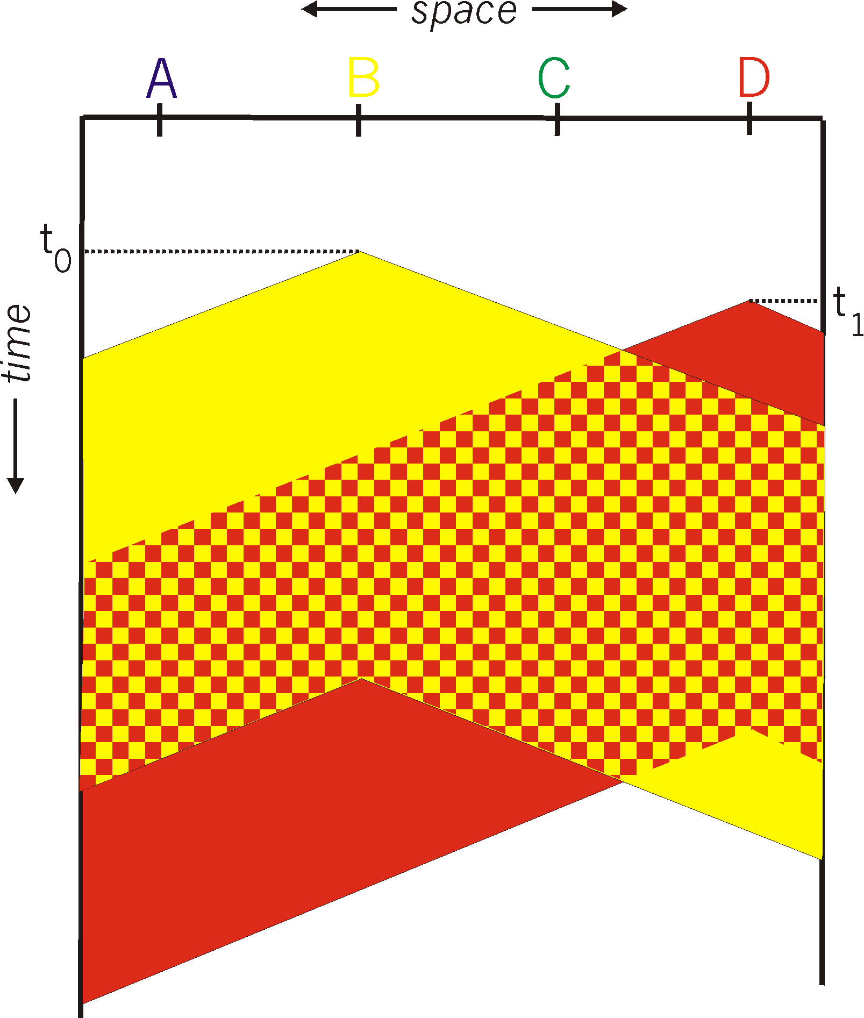
CSMA collisions
spatial layout of nodes
collisions can still occur: propagation delay means two nodes may not hear each other’s transmission
collision: entire packet transmission time wasted
distance & propagation delay play role in in determining collision probability

Slide 21
CSMA/CD (collision detection)
CSMA/CD: carrier sensing, deferral as in CSMA
collisions detected within short time
colliding transmissions aborted, reducing channel wastage
collision detection:
easy in wired LANs: measure signal strengths, compare transmitted and received signals
difficult in wireless LANs: received signal strength overwhelmed by local transmission strength

Slide 22
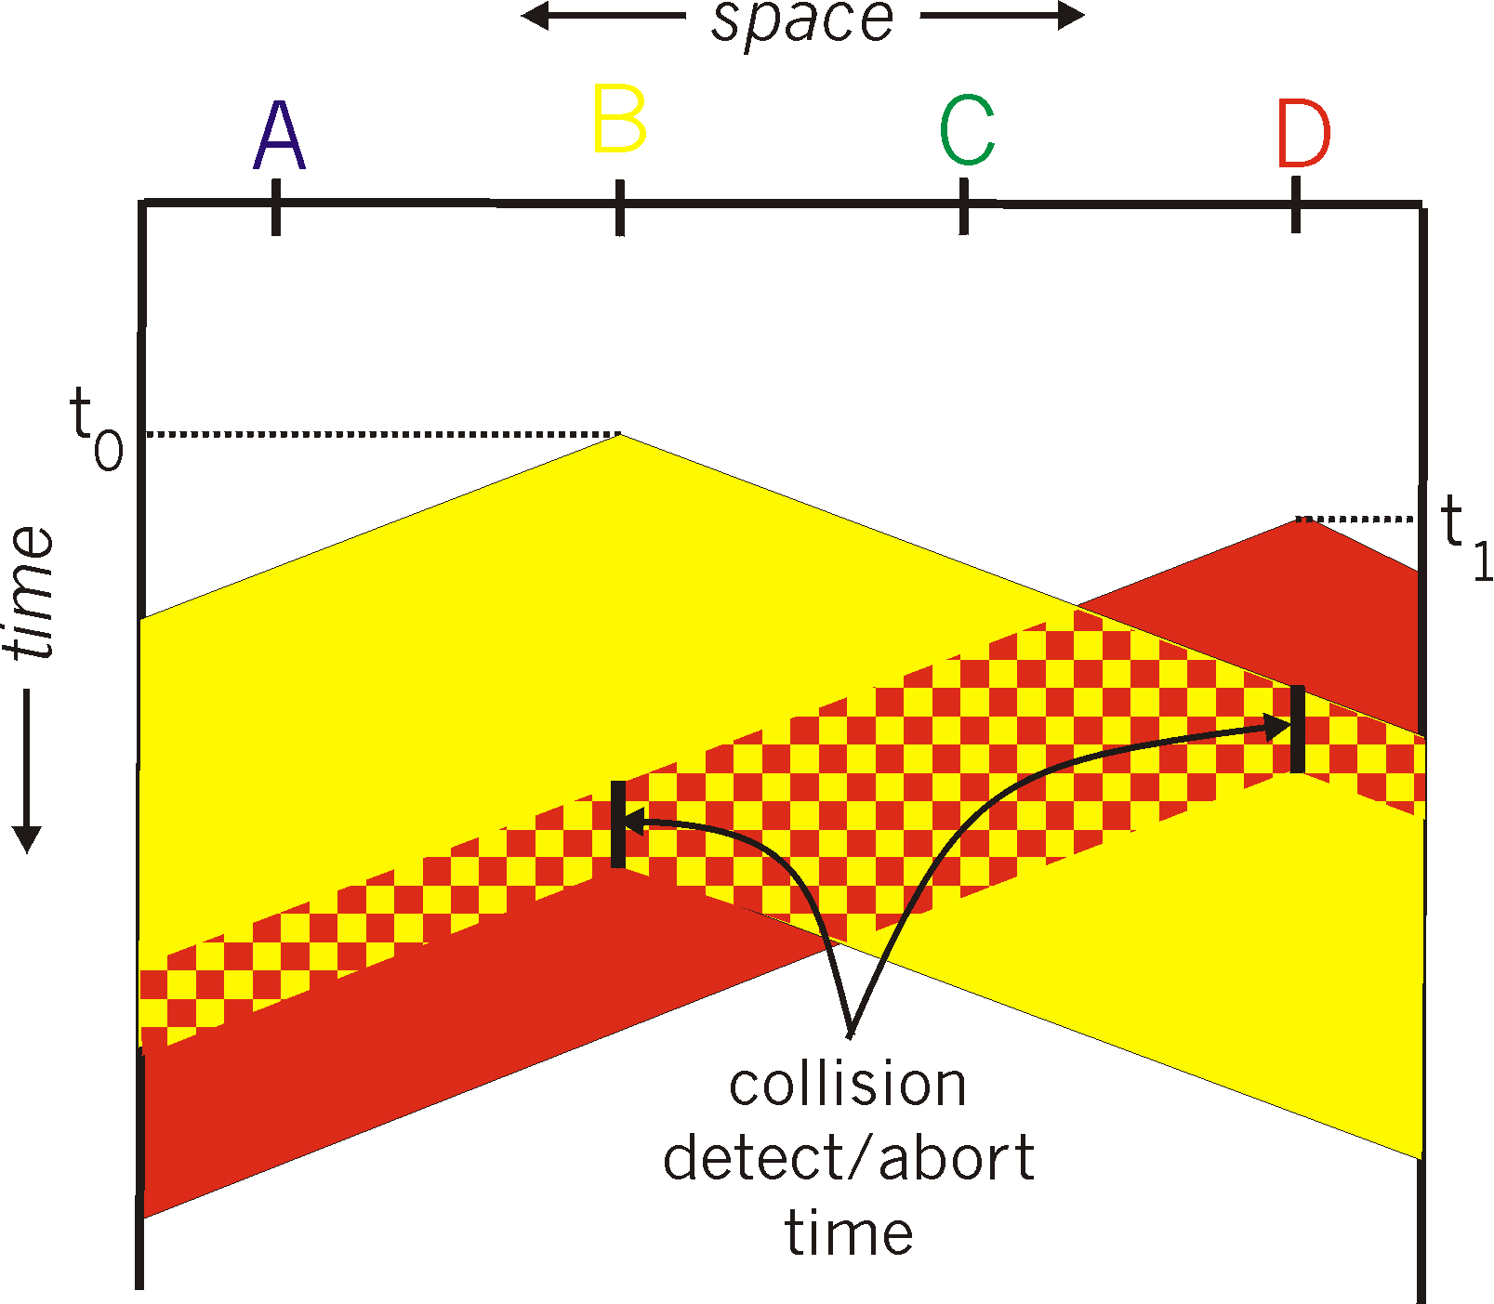
CSMA/CD (collision detection)
spatial layout of nodes

Slide 23
CSMA/CD algorithm
1. NIC receives datagram from network layer, creates frame
2. If NIC senses channel idle, starts frame transmission.
3. If NIC senses channel busy, waits until channel idle, then transmits (sometimes with prob. “p”). Why???
4. If NIC transmits entire frame without detecting another transmission, NIC is done with frame!
5. If NIC detects another transmission while transmitting, aborts and sends jam signal
6. After aborting, NIC of colliding stations enter binary (exponential) backoff:
after mth collision, NIC chooses K randomly from {0,1,2, …, 2^{m}-1}. NIC waits K·512 bit times, returns to Step 2
longer backoff interval with more collisions (m )

Slide 24
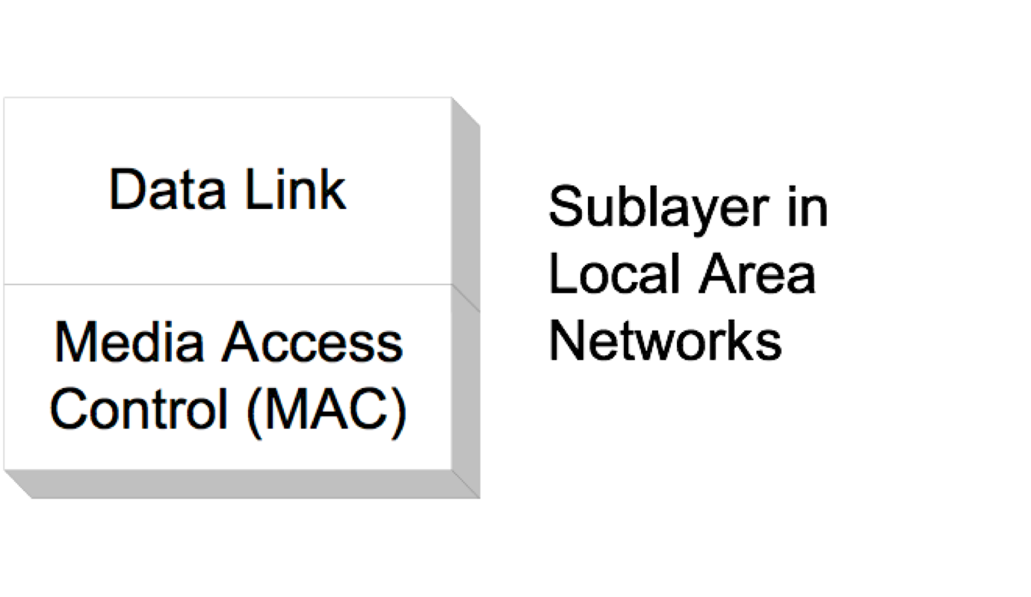
Data link layer for LANs
for Local Area Networks (shared links) the data link layer acquired a new task that is directly related to controlling access to the shared physical medium
to simplify functionality it split into two sublayers:
Logic Link Control (LLC) – usual datalink layer functions such as framing, error control, flow control, etc.
Media Access Control (MAC) – link access control mechanism
to gain access to the physical link - specific to shared environment
sits above physical layer
LLC

Slide 25
Link layer, LANs: outline
6.1 introduction, services
6.2 error detection, correction
6.3 multiple access protocols
6.4 LANs
Ethernet
IP and Link/MAC addresses
IPv4 and ARP
IPv6 addressing modes and NDP

Slide 26

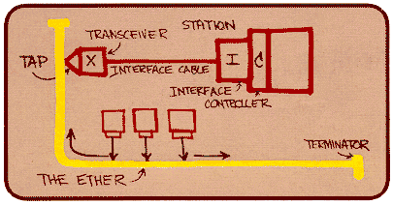
Ethernet
“dominant” wired LAN technology:
first widely used LAN technology
simple, cheap
multiple speeds over different types of physical layers
kept up with speed race: 100Mbps – 100+ Gbps
Metcalfe’s Ethernet sketch

Slide 27


Ethernet: physical topology
Broadcast – early implementation
bus: popular through mid 90s
all nodes on same bus, transmissions can collide, channel sensing helps
star: prevails today
hub in center
each “spoke” runs Ethernet protocol
hub broadcasts transmissions on all spokes, no buffering -> collisions
Point to point – current implementation – higher speeds
direct link: connects 2 devices, 2way communication, full/half duplex
star: switch in center
each “spoke” runs Ethernet protocol – switch buffers data, no collisions
Collision Zone
switch
hub
Buffers:
No Collisions
Maybe Overflows
bus: coaxial cable
star
Direct Link

Slide 28
Ethernet: Data Link Layer
Ethernet’s Services
connectionless: no handshaking between sending and receiving NICs
unreliable: receiving NIC doesn't send acks or nacks to sending NIC
data in dropped frames not recovered
relies on higher layers to recover if deemed important, otherwise dropped data lost
Ethernet’s MAC protocol
carrier sensing
collision detection
backoff when collision detected

Slide 29
Ethernet frame structure
device interface card encapsulates transmitted data in Ethernet frame
preamble:
7 bytes with pattern 10101010 followed by one byte with pattern 10101011
used to synchronize receiver, sender clock rates
type
preamble
dest.
address
source
address
data (payload)
CRC

Slide 30
Ethernet frame structure (more)
destination and source address: 6 bytes (referred to as octets)
adapter accepts frames with matching destination address, or broadcast address or recognized multicast address
it strips data link layer header and trailer and passes the payload to protocol layer identified in type field
adapter discards frames with unrecognized destination address
type: identifies which higher layer protocol’s data is being transported in the payload of the frame
CRC: cyclic redundancy check bits used by receiver to detect error
error detected: frame is dropped, no recovery
type
preamble
dest.
address
source
address
data (payload)
CRC

Slide 31
Ethernet standards
many different Ethernet standards exist do accommodate new physical layer speeds and mediums
different speeds: 2 Mbps, 10 Mbps, 100 Mbps, 1Gbps, 10 Gbps, 40 Gbps
different physical layer media: fiber, cable
all have common frame format and MAC protocol
application
transport
network
link
physical
MAC protocol
and frame format
100BASE-TX
100BASE-T2
100BASE-FX
100BASE-T4
100BASE-SX
100BASE-BX
copper (twisted
pair) physical layer
fiber physical layer

Slide 32
Link layer, LANs: outline
6.1 introduction, services
6.2 error detection, correction
6.3 multiple access protocols
6.4 LANs
Ethernet
IP and Link/MAC addresses
IPv4 and ARP
IPv6 addressing modes and NDP

Slide 33
Data link layer addresses
a device interface address can also be referred to as: Link/MAC/LAN/Ethernet/physical/hardware address
function: used ‘locally” to get data frame from one device interface to another device interface on same physical layer network – Ethernet, WiFi,…..,
address bits burned in ROM of device interface, also sometimes software settable
e.g.: Ethernet – 48bits (6octets): 1a-2f-bb-76-09-ad
ff:ff:ff:ff:ff:ff – all “1”s -> broadcast address on local network
hexadecimal (base 16 - 2⁴) notation
(each “numeral” represents 4 bits – 12x4=48)
2numerals = octet
1=0001, 9=1001, 10=a=1010
11=b=1011, 14=e=1110, 15=f=1111

Slide 34
Link addresses
each device on shared link has a unique link address, usually referred to as the MAC address, associated with interface card
devices can have more than one interface/adapter
devices can be attached to multiple networks
one link address per adapter (Ethernet, WiFi, cellular)
if point to point no address necessary
adapter
1a-2f-bb-76-09-ad
LAN
(wired or
wireless)
71-65-f7-2b-08-53
58-23-D7-FA-20-B0
0c-c4-11-6f-e3-98

Slide 35
MAC/Link addresses (more)
MAC/link address allocation administered by IEEE
manufacturers buy a range of MAC address space (to assure uniqueness)
address analogy:
MAC/link address: like Social Security Number (SSN)
Internet address: like postal address
MAC/link -> flat address, not location aware ➜ portable
device mobility - a device’s link card moves with the device
people move - their SSN goes along, does not change
Internet -> hierarchical address, location based ➜ not portable
address changes based on which (sub)network the device is currently located in, e.g., UCI, Cox OC, Sprint, Starbucks
people move - their postal address changes

Slide 36
Example
source
message
M
application
transport
network
link
physical
segment
H_{t}
M
H_{t}
datagram
H_{n}
H_{t}
M
frame
H_{l}
H_{n}
H_{t}
T_{l}
M
frame
frame
H_{l}
H_{n}
H_{t}
T_{l}
H_{l}
H_{n}
H_{t}
T_{l}
M
M
H_{x}: header
T_{x}: trailer
M: message
X: t - transport, n - network, l - link
link
physical
Hub (LAN)
destination
M
application
transport
network
link
physical
H_{t}
M
H_{n}
H_{t}
M
H_{l}
H_{n}
H_{t}
T_{l}
M

Slide 37

Local/Adjacent/Neighbor devices
a device can determine whether a destination is local (i.e., a neighbor on same network) or remote (different network), using the destination’s network address (IP address) –> comparing network prefixes (/x)
-> different -> remote -> same -> local
using postal address analogy, can identify if a destination is a neighbor living on same street or in a different town, state… etc.
a local destination, can be reached directly using the device’s link address
137.196.7.78/24
137.196.7.1
bd-c4-11-af-55-03
137.196.49.1
1a-2f-bb-76-09-ad
f4-18-13-df-57-93
137.196.7.23/24
LAN
137.196.7.14/24
137.196.49.51
LAN
71-65-f7-2b-08-53
58-23-d7-fa-20-b0
18-a4-d7-fa-20-c0
0c-c4-11-6f-e3-98
137.196.49.3/24
137.196.7.88

Slide 38
Remote devices
devices on different “networks” (e.g. 137.196.7.88 and 137.196.49.3) can only be reached via a router - that is connected to source’s network (i.e., is local)
path from source to a remote destination may involve multiple hops (router to router) to get to remote device’s network
137.196.7.78
137.196.7.1
bd-c4-11-af-55-03
137.196.49.1
1a-2f-bb-76-09-ad
f4-18-13-df-57-93
137.196.7.23
LAN
137.196.7.14
137.196.49.51
LAN
71-65-f7-2b-08-53
58-23-d7-fa-20-b0
18-a4-d7-fa-20-c0
0c-c4-11-6f-e3-98
137.196.49.3
137.196.7.88

Slide 39
Network to Link address translation
How to connect to a local device?
Point to point dedicated link, don’t need h/w address.
Shared/broadcast medium, need device’s link (h/w) address
Question: how to determine
a destination’s link address when all we know is its “network” address?
Answer:
IPv4: Address Resolution Protocol (ARP)
IPv6: Neighbor Discovery Protocol
137.196.7.78
1A-2F-BB-76-09-AD
137.196.7.23
137.196.7.14
LAN
71-65-F7-2B-08-53
58-23-D7-FA-20-B0
0C-C4-11-6F-E3-98
137.196.7.88

Slide 40
Takeaways
Roles of neighbor discovery (ND) and address resolution protocols
Address resolution in IPv4 (ARP)
Address resolution in IPv6 (NDP)

Slide 41
Neighbor discovery
Neighbor discovery refers to protocol functions that determine link-layer addresses of nodes that are attached to the same link
In IP terminology, “link” refers to any data link-layer network (point-to-point, broadcast)

Slide 42
Need for address translation
Note:
The Internet protocols are based on IP addresses
Many link-layer networks use MAC addresses (shared environments)
A translation is required between IP and MAC layer addresses
→ “Given an IP address, what is the MAC address?”
IPv4 and IPv6 use different protocols for the translation:
IPv4: Address Resolution Protocol (ARP)
IPv6: Neighbor Discovery Protocol (NDP)

Slide 43
Link layer, LANs: outline
6.1 introduction, services
6.2 error detection, correction
6.3 multiple access protocols
6.4 LANs
Ethernet
IP and Link/MAC addresses
IPv4 and ARP
IPv6 addressing modes and NDP

Slide 44
Address Resolution Protocol (ARP)
node A wants to send a datagram to node B (a local destination):
B’s IP address known to A
B’s MAC address not known to A
A broadcasts on local network an ARP request packet
request contains B’s IP address in data field
broadcast -> destination MAC address of the ARP request frame = ff:ff:ff:ff:ff:ff
all nodes on local network receive broadcast ARP request
B recognizes its IP address in request frame
B sends an ARP reply to A with its (B's) MAC address in the data field
destination MAC address of ARP reply frame = A’s MAC address (B extracted A’s MAC address from received ARP request).

Slide 45
ARP in action - request
Host Argon (node A) wants to send data to local router Router137 (node B) at IP address 128.143.137.1
Argon has to obtain Router137 MAC address
ARP request from Argon: Argon broadcasts on data link layer (address: ff:ff:ff:ff:ff:ff) an ARP request to all stations on the network:
“What is the MAC address of 128.143.137.1?”
128.143.137.1?

Slide 46
ARP in action - reply
ARP Reply from Router137: Router 137 responds with an ARP Reply which contains its MAC address 00:e0:f9:23:a8:20 and is sent in data link frame to ARGON at address 00:a0:24:71:e4:44
“MAC address of 128.143.137.1 is 00:e0:f9:23:a8:20”
128.143.137.1

Slide 47
ARP Transport
ARP message travels in data portion of data link layer frame
we say ARP message is encapsulated in data link frame
query/request has:
destination address: broadcast - ff:ff:ff:ff:ff:ff
source address: requesting device’s MAC address
reply has:
destination address: of requesting device
source address: responding device’s MAC address
data portion of link frame padded with zeroes if ARP message is shorter than minimum data link frame (depends on hardware address length and network address length)

Slide 48
ARP Packet on Ethernet Link
e.g., IP
e.g., Ethernet
e.g., IP = 32
e.g., Ethernet = 48
for Ethernet: frame type field 0x0806 is used to denote ARP message

Slide 49
ARP Packet Format
general: can be used with
arbitrary hardware address (not just Ethernet)
arbitrary network protocol address (not just IP)
variable length address fields (depends on type of data link and network protocol)

Slide 50
Example content of ARP packet for Ethernet and IP
ARP Request from Argon:
Source hardware address: 00:a0:24:71:e4:44 Source protocol address: 128.143.137.144 Target hardware address: 00:00:00:00:00:00 Target protocol address: 128.143.137.1
ARP Reply from Router137:
Source hardware address: 00:e0:f9:23:a8:20 Source protocol address: 128.143.137.1 Target hardware address: 00:a0:24:71:e4:44 Target protocol address: 128.143.137.144
Argon
Router
Router
Argon

Slide 51
Retention of Bindings
sending an ARP request/reply for each IP datagram to same IP address is inefficient
solution -> maintain a table of bindings (ARP Neighbor cache)
devices maintain a neighbor cache of currently used network addresses and their corresponding hardware addresses
Network to MAC address mappings for neighboring nodes:
< Network address; Dev interface; MAC address; State>
entries in cache have different states – change with time
effect
use ARP for first datagram to a destination, place results in table, then quick lookup for MAC address for subsequent packets sent to that same IP address

Slide 52
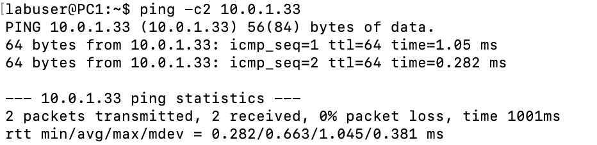
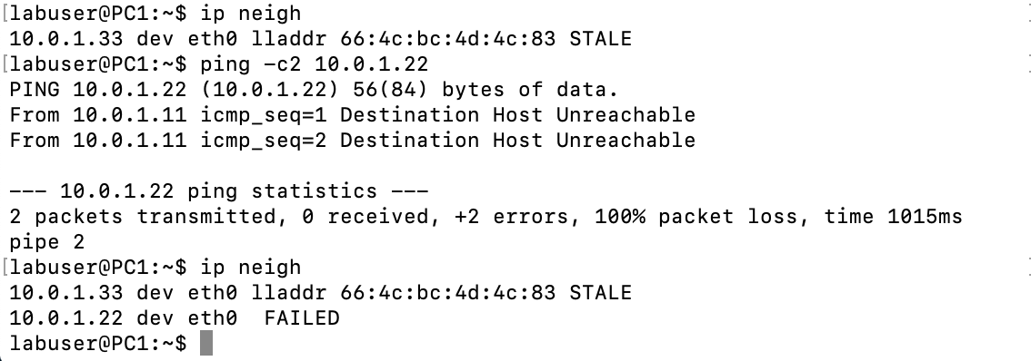
Example ARP Neighbor Cache
Ping PC1 to PC3 - Successful
Ping PC1 to PC2 - Failed

Slide 53
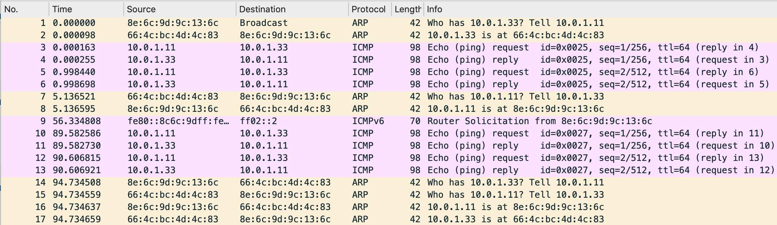
Ping Scenario Msg Exchange
1st ping
PC1-PC3
2nd ping
PC1-PC3
ARP messages during a ping Observed for a ping PC1→ PC3 on an empty ARP cache:
PC1→Bcast: ARP Request broadcast for IP address of PC3.
(Note: ARP cache at PC3 is updated with PC1, using the incoming ARP Request.)
PC3→ PC1: ARP Reply from PC3 (sent as unicast)
PC1←→PC3: ICMP messages (PC3 has not yet sent ARP Request for PC1)
PC3→ PC1: 5 seconds after last ICMP message: ARP Request sent from PC3 to PC1 as unicast to validate the cache entry
PC1→PC3: sends ARP Reply also as unicast.
Once ARP cache entries are stale, and the ping PC1→ PC3 is repeated, ARP Requests/Reply by
both PC1 and PC3 are sent after the ICMP messages.

Slide 54
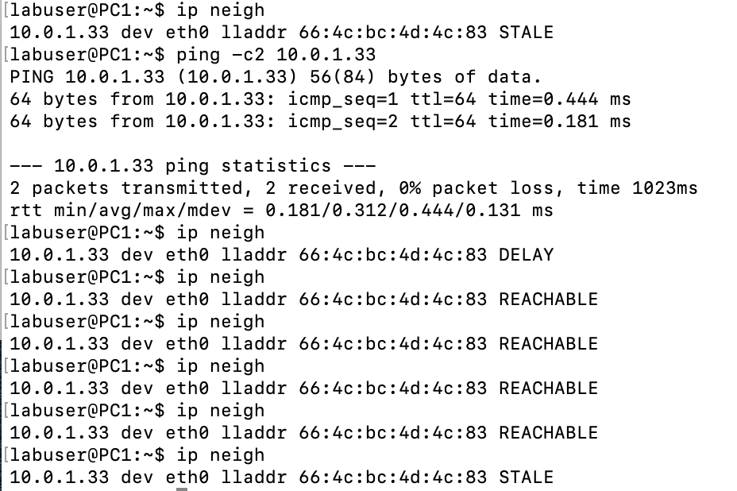
Arp Neigh Cache – PC1
1st ping PC1 -> PC3
After a few secs reachable entry becomes stale
2nd ping PC1 ->PC3
Cache entry states change:
Stale (activity) to Delay (waiting for verification via solicitation)
to Reachable (received advertisement) to Stale (no activity for 30secs)
in a neighbor cache

Slide 55
State of the ARP Neighbor Cache
States of neighbor cache entries for ARP messages during anexchange
permanent the neighbor entry is valid forever and can be only be removed administratively.
noarp the neighbor entry is valid. No attempts to validate this entry will be
made but it can be removed when its lifetime expires.
reachable the neighbor entry is valid until the reachability timeout expires.
stale the neighbor entry is valid but suspicious. After 30 sec, “reachable” becomes “stale”.
none this is a pseudo state used when initially creating a neighbor entry or after trying to remove it before it becomes free to do so.
incomplete the neighbor entry has not (yet) been validated/resolved.
delay neighbor entry validation is currently delayed.
probe neighbor is being probed.
failed max number of probes exceeded without success, neighbor validation has ultimately failed.

Slide 56
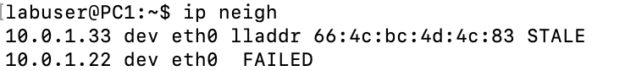
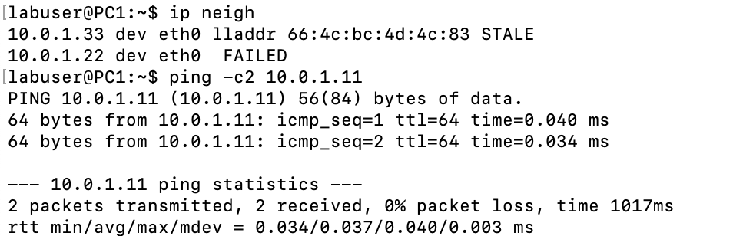
Notes on ARP usage
what happens if an ARP request is made for a non-existing host?
several ARP requests are made, eventually ARP gives up
what if a host sends an ARP request for its own IP address?
know as gratuitous ARP
not transmitted by device over link, stays local -> check on its own IP address locally

Slide 57
Link layer, LANs: outline
6.1 introduction, services
6.2 error detection, correction
6.3 multiple access protocols
6.4 LANs
Ethernet
IP and Link/MAC addresses
IPv4 and ARP
IPv6 addressing modes and NDP

Slide 58
IPv6 Addresses
IPv6 addresses are huge – 128bits long!!!
IPv6 addresses use hexadecimal notation with colons -> abbreviation rules are used to shorten notation
IPv6 uses CIDR notation -> prefixes
structure of an IPv6 address is complex and identifies type of address
IPv6 address includes the MAC/hardware address

Slide 59
Notation of IPv6 addresses
IPv6 addresses are written as hexadecimals
“Blocks” of 16 bits are separated by colons
abbreviation is used to simplify notation

Slide 60
IPv6 Address and Abbreviation rules
FE80:0000:0000:0000:002A:0000:0000:0A81
Leading zeros in a block can be omitted
One (but only one) group of contiguous blocks with all zeros can be replaced by a double colon
FE80:0000:0000:0000:002A:0000:0000:0A81
FE80:0:0:0:2A:0:0:A81
FE80::2A:0:0:A81
FE80:0:0:0:2A:0:0:A81
FE80:0:0:0:2A::A81
Best abbreviation yields the correct notation:
FE80::2A:0:0:A81

Slide 61
CIDR notation for IPv6 addresses
IPv6 addresses are written in CIDR notation
2607:F2C0:92C7:4A00:1053:D1D1:66E9:41EA/64
The number after the slash (/) is the prefix length, which identifies the network part (network prefix)
All interfaces on the same subnet have the same network prefix
The only differences with IPv4 are the hex notation and the length of the addresses
128 bits
64 bits
64 bits
2607:F2C0:92C7:4A00
1053:D1D1:66E9:41EA
prefix length
Notes:
RFC 3587 (earlier allocation was defined in RFC 2374)

Slide 62
CIDR notation for IPv6 address blocks
128 bits
48 bits
80 bits
2607:F2C0:92C7
0000:0000:0000:0000:0000
Prefix length
Network address blocks use CIDR notation
An address block is written as the first address in the block (ending in all zeroes) followed by the prefix length:
2607:F2C0:92C7::/48
First address: 2607:F2C0:92C7:0000:0000:0000:0000:0000 Last address: 2607:F2C0:92C7:FFFF:FFFF:FFFF:FFFF:FFFF
Notes:
RFC 3587 (earlier allocation was defined in RFC 2374)

Slide 63
Example of IPv6 address block
IPv6 prefix of company XYZ: 2606:FA00::/32
Number of addresses: 2¹²⁸⁻³²⁼⁹⁶
= 79,228,162,514,264,337,593,543,950,336 ≈ 8 x 10²⁸
Or 2¹²⁸⁻⁶⁴⁼³² subnets with 2⁶⁴ host numbers
from:
to:
Interface ID
Subnet ID

Slide 64
Types of IPv6 addresses
 | IPv6 Prefix
Global unicast | 2000::/3
Link-local unicast address | FE80::/10
Unique local unicast address (ULA) | FC00::/7
Multicast | FF00::/8
2000=0010000
/3
FE80=1111111010000
/10
FC00=1111110000
/7
FF00=1111111100
/8
Broadcast: No broadcast address in IPv6
Anycast: Any unicast address can be designated as an anycast address
Anycast: assigning the same IP address to several devices., generally routers, where only one in a group needs to be reached.
What is different from multicast?: The anycast address is very similar to the multicast address, but packets will be delivered to only one random host in the group, usually the closest one, instead of the entire group. Every device with an Anycast address, will also have a unique IPv6 address where it can be reached at ( and that does not include the link-local, which every device has).

Slide 65
Delivery methods and IPv6 address types
Unicast ✓
Broadcast ✕
Multicast ✓
Anycast ✓
unicast
broadcast
multicast
anycast
2000::/3 FE80::/10 FC00::/7
No broadcast
FF00::/8
Any unicast address can be designated as anycast address

Slide 66
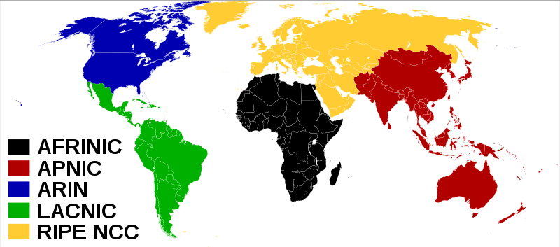
Currently available global unicast addresses
All currently assigned global routing prefixes are taken from 2000::/3 prefix up to /12 and are required to have 64bit interface IDs (usually EUI format of MAC address)
2A00::/12
00101010000000::/12
2600::/12
00100110000000::/12
2A00::/12
2600::/12
2C00::/12
2400::/12
Note: Several additional smaller blocks (longer prefixes) have also been assigned.
2800::/12
2400::/12
0010010000000::/12
2800::/12
00101000000000::/12
2000::/3
Range of Global unicast IPv6 addresses is 2000 to 3FFF (prefix /12)
i.e., 0010000000000000 lowest to 0011111111111 highest

Slide 67
Reserved IPv6 addresses (selection)
 |  | CIDR notation
Unspecified (not assigned, indicates absence of an address) | All zeros | ::/128
Loopback | Last bit is one, all other bits zero | ::1/128
Router(s) on the local subnet (anycast address) | Interface identifier set to all zeros | Example: 2607:f2c0:92c7::/48
Reserved for anycast addresses | Largest 128 addresses on a subnet

Slide 68
Global unicast address (2000::/3)
Global routing prefix
is allocated from an internet service provider (ISP) or registry (RIR)
typically, 32 ≤ N ≤ 64
Subnet ID is determined locally (0-32bits)
Interface ID
→ length 64 bits
→ is typically built using EUI-64 format of MAC address, or an alternative method, e.g., encrypted number, randomly generated number (4, 122,….)
Notes:
RFC 3587 (earlier allocation was defined in RFC 2374)

Slide 69
Link-local unicast address (FE80::/10)
FE80::/10
FE80
Everyone listens to FE80
Everyone recognizes their local
EUI-64 address
IPv6 requires that each interface has a link-local address, even if it has a global unicast address
Link-local address is used whenever device is communicating with nodes on same subnet
Packets with the FE80 address are local to a subnet (not forwarded by routers)
Interface ID is generated automatically, e.g., with EUI-64
All devices read FE80 packets. A device recognizes its EUI and responds to the neigh solicitation with its link address.

Slide 70
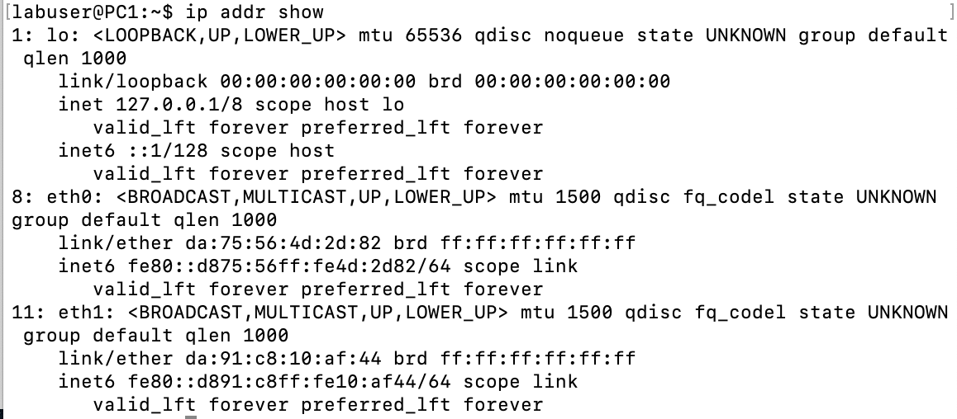
IPv6 Addressing on a Lab Host
Link-local unicast address:
created by host
not routable outside subnet
eth0
eth1
EUI created from:
da:75:56:4d:2d:82

Slide 71
Issue with Link-local unicast address
FE80
Since all link-local addresses have the same network prefix, a system with multiple interfaces has the same network prefix on all interfaces
Issue: If the system wants to send a packet to one of the connected subnets, how does it know which interface to pick?
Solution: Internally, a system adds an additional identifier to the link-local address (Zone Index)
Routing tables use zone index for all link-local addresses
Zone index can be an index or name of interface:
fe80::21f:f3ff:fec5:dc47%1 fe80::21f:f3ff:fec5:dc47%eth1

Slide 72
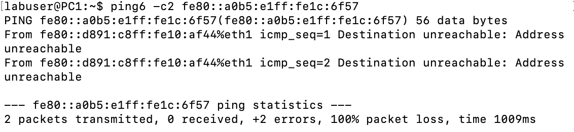
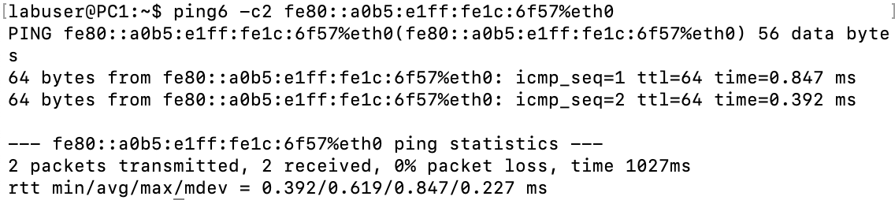
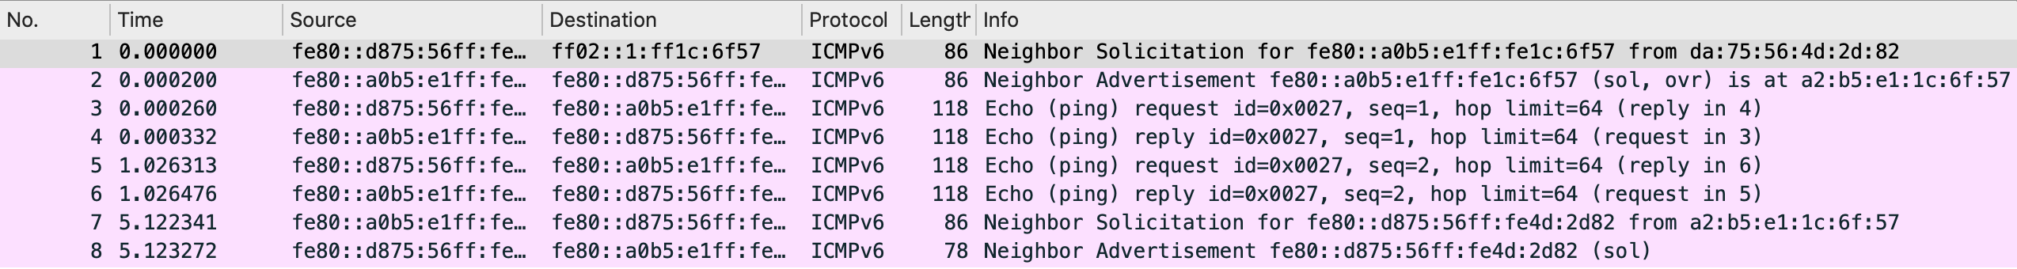
Example of Ping6: Link-Local
Ping link-local unicast: a) no zone index, b) zone index
a)
b)

Slide 73
Unique Local Unicast Address (ULA)
FC00::/7
ULA addresses play the same role as private addresses in IPv4
ULA addresses are intended for communication within an organization
Packets with this address may be routed within an administrative domain, but are not globally routable
Address block FC00::/7: F110x00 is divided into two parts:
x =1: Global ID - locally assigned -> F110100::/8 – FD00/8 -> Private network address (similar to 10.0.0.0 in IPv4)
x =0: not defined -> F110000::/8 - FC00::/8)
x=1 -> Global ID, 40bits - randomly selected, subnet ID here = “1”, and Interface ID = “1”
NOTE: ULA addresses will be the IPv6 configured addresses in our labs – locally assigned -> so x=1
You will be given a Global ID, Subnet ID and x =1 -> fd+Global ID+Subnet ID +Interface ID (host number (64bits)
The host number is equivalent to rightmost bits in the IPv4 address identifying the host number (IP address w/o network prefix)

Slide 74
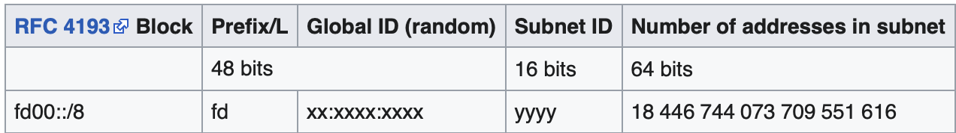
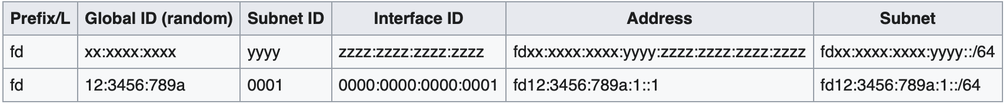
Examples of ULA
A routing prefix may be constructed by generating a random 40 bit hexadecimal string,
taken e.g., to be 0x123456789a. The string is appended to the prefix fd00::/8.
This forms the 8+40=48-bit routing prefix ”fd12:3456:789a::/48”.
With this “48” prefix, 2¹⁶=65536 subnets of size 2⁶⁴ hosts addresses can be configured.
And the host address space is fd12:3456:789a::/64 to fd12:3456:789a:ffff::/64.
E.g., with subnet ID “0001” the subnet would be: fd12:3456:789a:1::/64
Also called host number
128bits
fd12:3456:789a:1::1/128
IPv6 Host Address

Slide 75
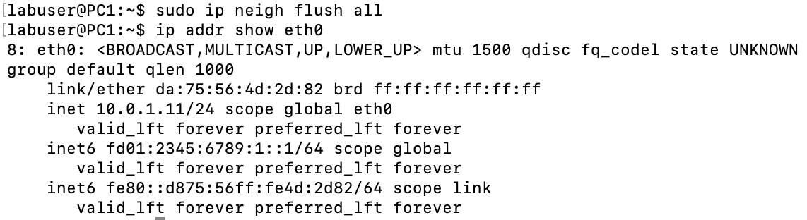
IPv6 Addressing on a Lab Host
Unique unicast address:
configured on host
routable only inside an administrative domain - AS
showing for eth0 interface
fd01:2345:6789
11111101
Global ID
Subnet ID
Interface ID

Slide 76
EUI-64 Address
In IPv6, the interface ID is an EUI-64 address
IEEE EUI-64 is essentially a 8-byte MAC address
EUI-64 address is created from a 48-bit MAC address
FF
FE
Rules:
Insert: FF:FE after 3rd byte
Invert the 7th bit of 1st byte
EUI-64 Identifier
CA
C8
2A
14
C8
2A
14
MAC Address
0
1
1
0
0
1
0
1
0
0
Notes:
Why the ”flipped bit”?
The 7th bit of the 1st byte is designated as the U/L (Universal/Local) bit. If U/L=0, the address is globally unique. if U/L=1, the address is locally administered (possibly not globally unique).
MAC addresses of interface cards have U/L=0. So, when (locally) creating a EUI-64 for an IPv6 address, it makes sense to setting U/L=1. However, on a virtual machine the MAC addresses of the virtual interfaces are locally created, and, consequently, the MAC address has U/L=1. When creating an EUI-64 address, it would make sense to leave the value U/L=1. However, this is not what is happening. When creating an IPv6interface identifier, the EUI-64 address is set to U/L=0. This obviously does not make sense (since it declares a non-unique address to be globally unique).
It appears that no protocol ever makes a decision based on the U/L bit. So, this logical flaw has no impact.

Slide 77
EUI-64 Address
Rules:
Insert: FF:FE after 3rd byte
Invert 7th bit of 1st byte

Slide 78
Alternatives to EUI-64
In IPv6, interface identifiers are always automatically generated
There exist alternative methods (to EUI-64):
Cryptographically generated addresses
Randomly generated
The motivation for these alternatives are privacy and security concerns
In EUI-64 the Interface Id is fixed when a system is moving to a different subnet
This gives away information about the system

Slide 79
ICMP Neighbor Solicitation ICMP Neighbor Advertisement
Function:
Used in Neighbor Discovery Protocol (NDP) - replacement for ARP
Duplicate Address Detection
Messages are sent via
solicited node multicast for NDP
unicast (for address validation)

Slide 80
Solicited node multicast address
Suppose H1 looks for the MAC address of H3
Without broadcast, how can H1 reach H3?
-> Neighbor Solicitation
- a solicited node multicast message
- it’s address is an all nodes multicast address with prefix = 104 –> ff02::1:ff00:00/104
- the message address has the 3 last bytes extracted from solicited node’s IP address

Slide 81
Solicited node multicast address
Suppose H1 looks for the MAC address of H3
Problem: How can H1 reach H3 without broadcast?
When H3 configures its IPv6 unicast address, it starts listening to messages sent to its solicited multicast address
When H1 looks for the MAC address of H3, it sends a Neighbor Solicitation to the solicited multicast address derived from H3’s IPv6 address

Slide 82
IPv6 Multicast Address (FF00::/8)
FF00::/8
Four flags: 0RPT
0: first flag is always zero - reserved
R=1: Group ID contains address of rendezvous point
P=1: Group ID based on network prefix
T=0: well known multicast address (otherwise dynamically assigned)
Scope defines area of validity of group ID (local to global)
Predefined multicast addresses exist (scope identified)
FFx2::/16 link local, e.g., on a local single segment: all routers: FF02::2, all nodes: FF02::1 (used for Neighbor Discovery Protocol)
FFx1::/16 loopback (like 127.0.0.0/8 in IPv4)
FFx8::/16 private networks (unique local – multicast across whole network)
FFxE::/16 global routed over Internet – global multicast

Slide 83
Solicited node multicast address
A solicited node multicast address of an IPv6 host is derived from a host’s unicast (or anycast) IPv6 address and the all nodes local multicast prefix
all nodes local multicast prefix: FF02::1:FF00:0/104
plus last 3 bytes from unicast address
00:00
13 bytes
3 bytes
unicast IPv6 node
address
1B00:0408:135D:FD0B:0D4B:2607:F2
C0:92C7
solicited IPv6 node multicast address
FF02:0000:0000:0000:0000:0001:FF
C0:92C7
Solicited multicast message: FF02::1:FF00:0
+
C0:92C7
Local subnet all nodes multicast

Slide 84
Multicast IPv6 mapping to multicast Ethernet Address
IPv6 Multicast Solicitation Address of a host is obtained from the all nodes multicast address- ff02::1
ff02::1:ffxx:xxxx
where “ff” denotes address solicitation multicast
and the 3 bytes of xx are the last 3 bytes of the host address
e.g.: ff02::1:ff43:a6:f3 is the host multicast address
The MAC multicast address for this host is 6 octets with
first 2 ALWAYS set to 33:33
And last 4 octets are the last 4 bytes of the IP multicast address
e.g., in multicast address above - ff:43:a5:f3
So multicast MAC address is: 33:33:ff:43:a5:f3

Slide 85
Neighbor Discovery Protocol
Uses several ICMPv6 messages types:
Neighbor Solicitation / Neighbor Advertisement
Router Solicitation / Router Advertisement,
Route Redirect
Functions:
Address resolution
Duplicate Address Detection (DAD)
Router/prefix/parameter discovery
Address autoconfiguration – Link-Local
Next-hop determination
Neighbor unreachable detection
Notes:
RFC 2461, Dec 1998

Slide 86
Neighbor Discovery Protocol (NDP)
In IPv6, the Neighbor Discovery Protocol (NDP) replaces ARP
No broadcast: NDP messages are sent as multicast or unicast
No separate protocol: NDP messages are sent as ICMP messages
Enhanced functions: Detection of duplicate addresses when assigning IP address – sends Neighbor Solicitation msg
Each node has a neighbor cache that stores (IPv6, MAC) address mappings
Two messages
ICMP Neighbor Solicitation
ICMP Neighbor Advertisement

Slide 87
Node Solicitation packet format
Target address is the IPv6 address to be resolved (Global unicast, or Link-Local or Unique Local Unicast)
Option is used unless source IPv6 address is “::” i.e., null (never “null” for NDP) It contains the MAC address of the sender of the solicitation. The address is used for the reply to the solicitation

Slide 88
Node Advertisement packet format
Target address is the IPv6 address to be resolved
Bit flags: R (Router flag): set if sender is a router S (Solicited flag): set if this is a reply to a solicitation O (Override flag): set if this advertisement should override neighbor cache entry
Option is required (response to solicitation) It contains the MAC source address of the sender of the advertisement

Slide 89
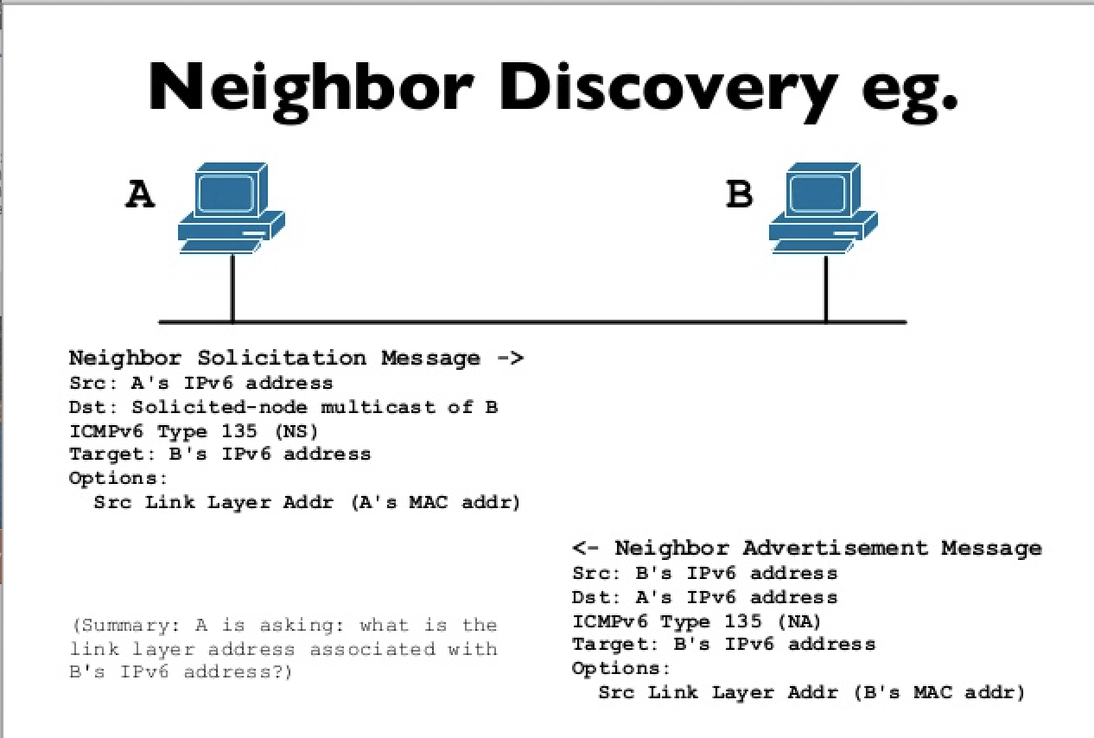
Neighbor Discovery Protocol (NDP)
A wants to connect with B
A knows B’s IP address
A does not know B’s MAC
If IP source address is IP address of A,
provide A’s MAC address – required for
NDP
Required for NDP –> A’s IP address is given

Slide 90

NDP example
2606::PC1
2606::PC2
Example:
Scenario: PC1 issues a ping to PC2 configured
Observe: NDP resolves configured and link-local addresses
PC1
PC2
2606::PC1 (2606::PC2) Configured IPv6 address of PC1 (PC2) FE80::PC1 (FE80::PC2) Link-local IPv6 address of PC1 (PC2) FF02:PC2 Solicited node multicast address of PC2
PC1
PC2

Slide 91
NDP Example
2606::PC1 (2606::PC2) : Configured IPv6 address of PC1 (PC2) FE80::PC1 (FE80::PC2) : Link-local IPv6 address of PC1 (PC2) FF02:PC2: Solicited node multicast address for address of PC2.
ICMP messages are omitted
PC1
PC2
Source IPv6
Destination IPv6
Neighbor Solicitation for 2606::PC2
2606::PC1
FF02::PC2
Neighbor Advertisement for 2606::PC2
2606::PC2
2606::PC1
Neighbor Solicitation for 2606::PC1
FE80::PC2
2606::PC1
Neighbor Advertisement for 2606::PC1
2606::PC1
FE80::PC2
Neighbor Solicitation for FE80::PC2
FE80::PC1
FE80::PC2
FE80::PC2
FE80::PC1
Neighbor Advertisement for FE80::PC2
FE80::PC2
FE80::PC1
Neighbor Solicitation for FE80::PC1
Neighbor Advertisement for FE80::PC1
FE80::PC1
FE80::PC2

Slide 92
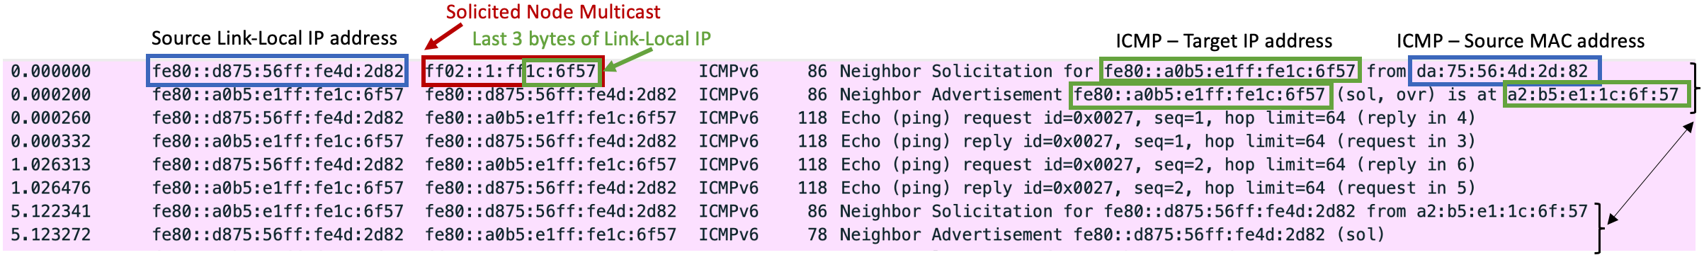
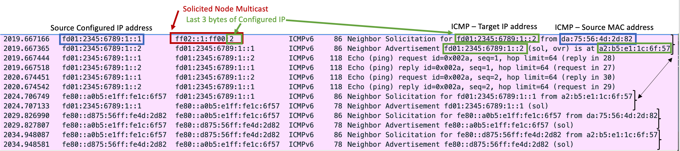
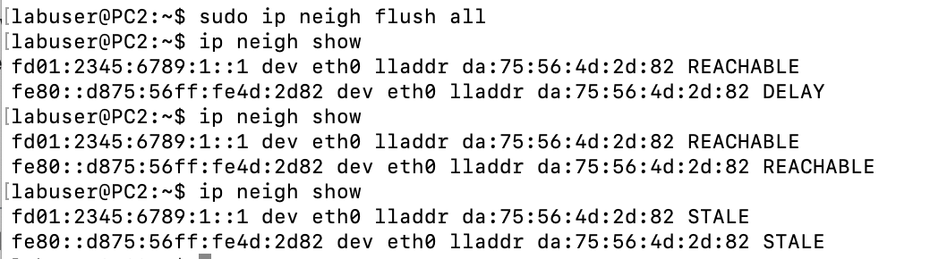
Wireshark- Ping6: link-local and configured
PC1 | fe80::3c34:9cff:fe6c:887f/64
PC2 | fe80::a8f2:89ff:fe83:a2f5/64
PC3 | fe80::1080:7dff:feb1:75b8/64
PC4 | fe80::7c83:d6ff:fe31:735f/64
PC1 | fd01:2345:6789:1::1/64
PC2 | fd01:2345:6789:1::2/64
PC3 | fd01:2345:6789:1::3/64
PC4 | fd01:2345:6789:1::4/64

Slide 93
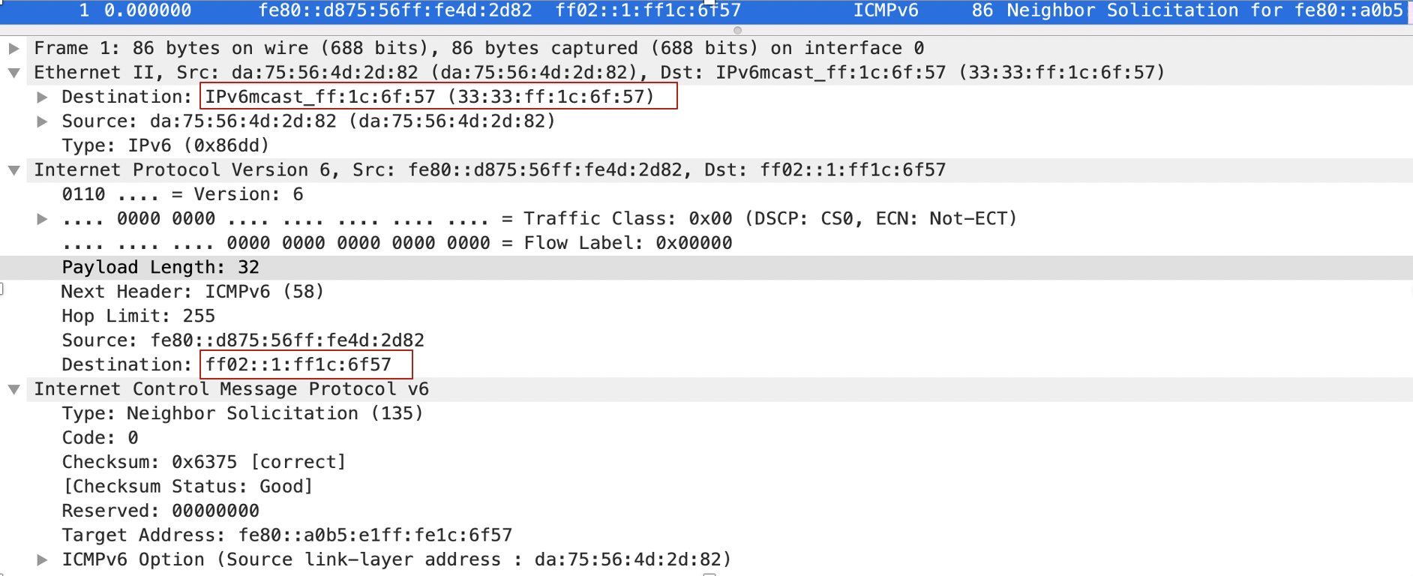
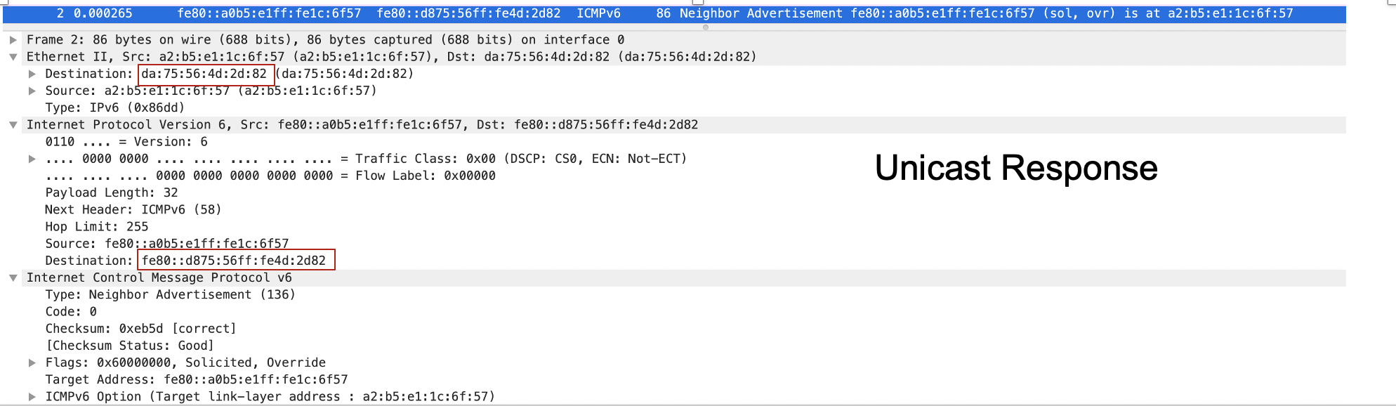
Multicasting to find the Host

Slide 94
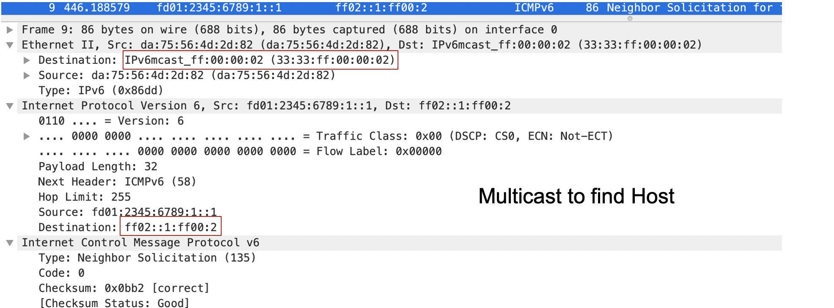
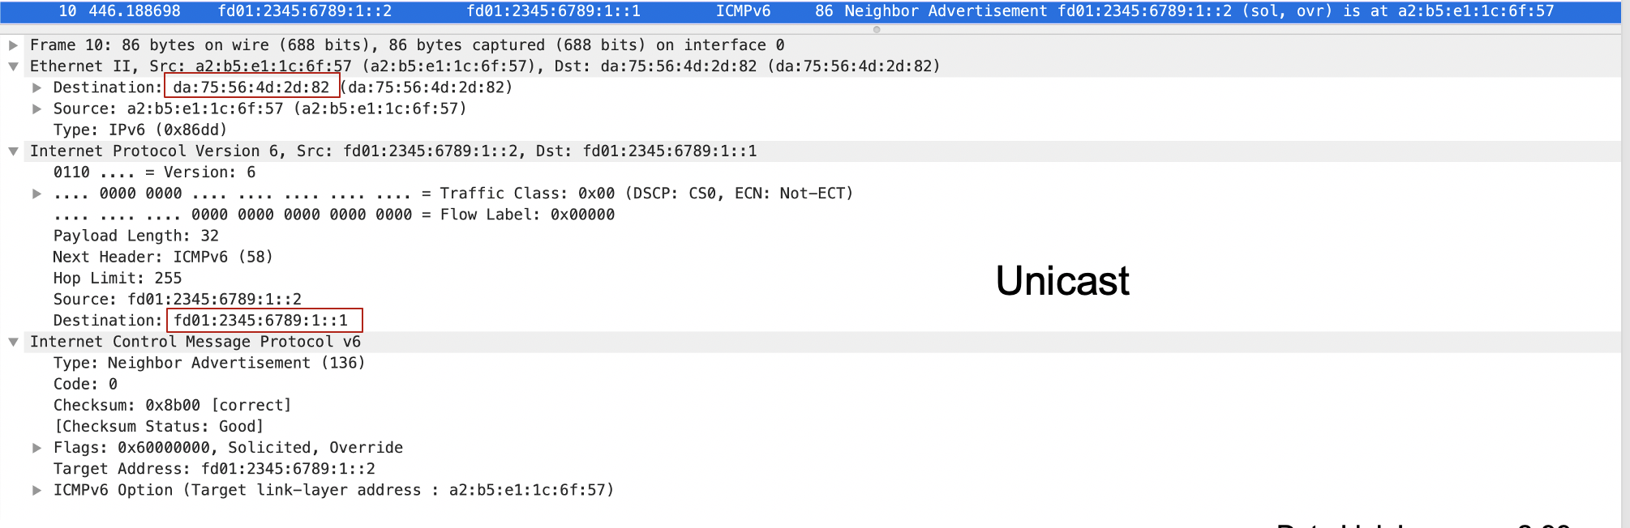

Slide 95
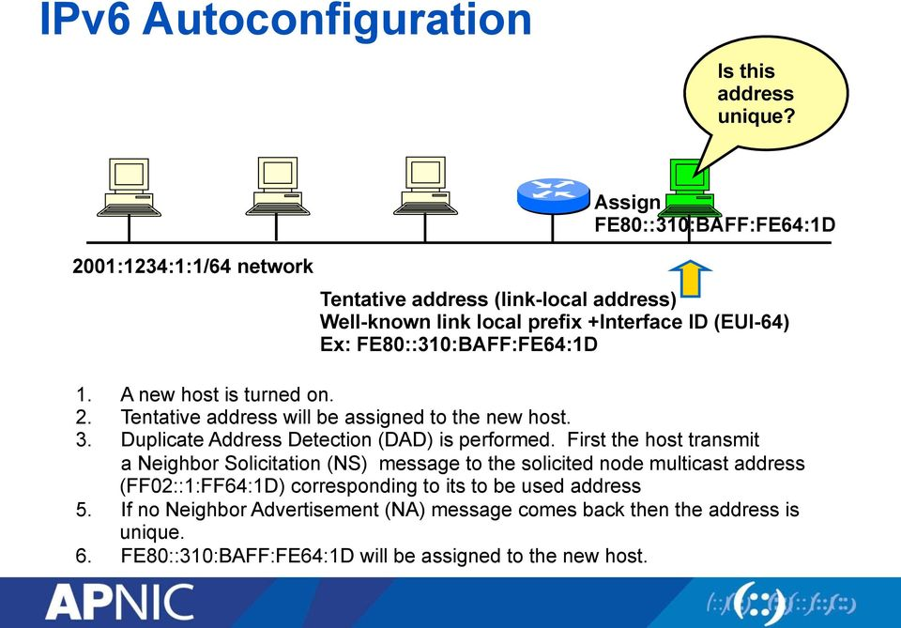
Duplicate Address Verification

Slide 96
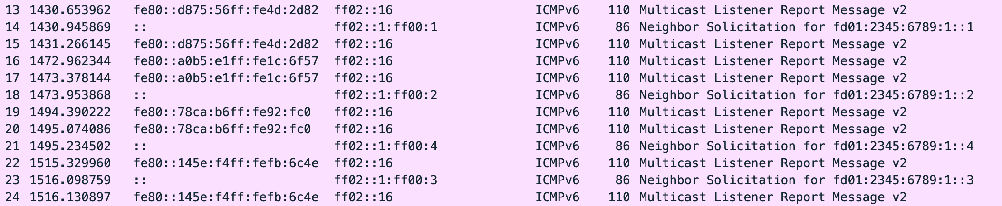
IPv6 configures a unique unicast address
IPv6 checks for uniqueness of the IP address by sending a Neighbor Solicitation
No response, implies no one has that address.
PC1 | fe80::3c34:9cff:fe6c:887f/64
PC2 | fe80::a8f2:89ff:fe83:a2f5/64
PC3 | fe80::1080:7dff:feb1:75b8/64
PC4 | fe80::7c83:d6ff:fe31:735f/64
PC1 | fd01:2345:6789:1::1/64
PC2 | fd01:2345:6789:1::2/64
PC3 | fd01:2345:6789:1::3/64
PC4 | fd01:2345:6789:1::4/64
Source addresses:
Link-local - multicast listener
Or
All set to zero – neighbor solicitation
Destination addresses:
Multicast all routers - multicast listener
Or
Multicast address – solicited node multicast
(derived from node assigned IP address)

Slide 97
Duplicate Address Detection (DAD)
Used to determine uniqueness of an IPv6 address on a link
When a network address is configured at H1:
H1 starts listening to the solicited node multicast address (derived from H1’s configured address)
H1 sends an ICMP Neighbor Solicitation with its own address as target (with source address :: and the destination set to H1’s solicited node multicast address)
If there is no response, the configured address is considered unique
If there is a response, a duplicate address has been detected. H1 marks the address as unavailable and stops listening to the solicited node multicast address.

Slide 98
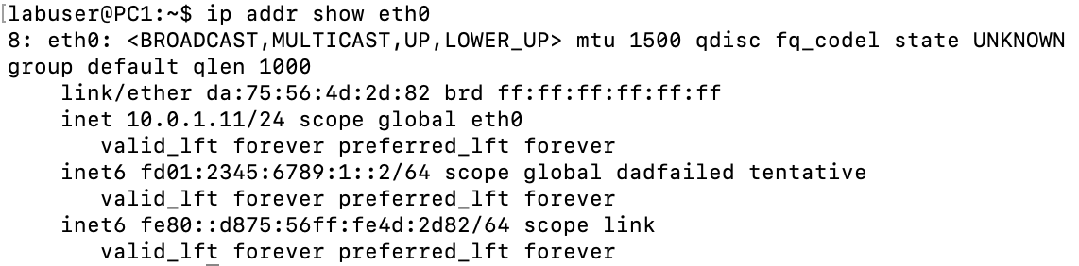
IPv6 and Duplicate Addresses
When trying to configure PC1 with these 2 IPv6 addresses on eth0:
PC1 will not be able to configure the ::2 address.
It checks for address by sending out a solicitation
If a response comes back from another device, means address taken
fd01:2345:6789:1::1/64
fd01:2345:6789:1::2/64
NOTE: ::2 address already assigned to PC2
-> duplicate

Slide 99
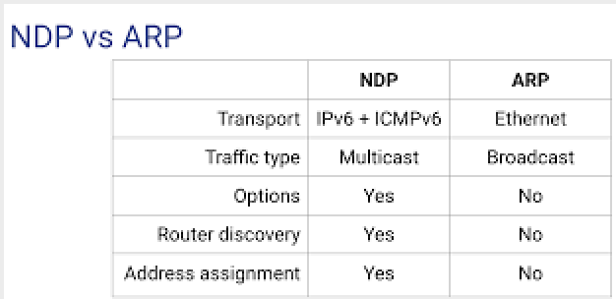
NDP and ARP Comparison
NDP operates at the application layer – it is a network application, transported via ICMP protocol over IP
ARP operates in a layer that sits in between Network and Data Link layers, transported via data link layer
NDP provides more than just Link address discovery

Slide 100
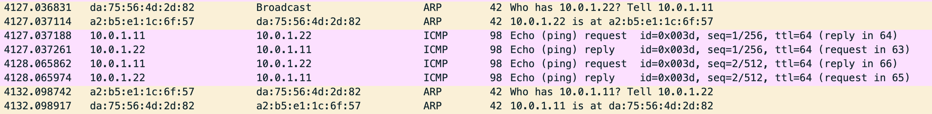
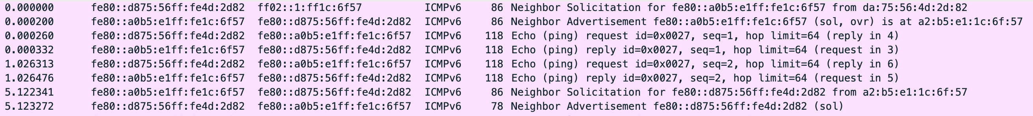
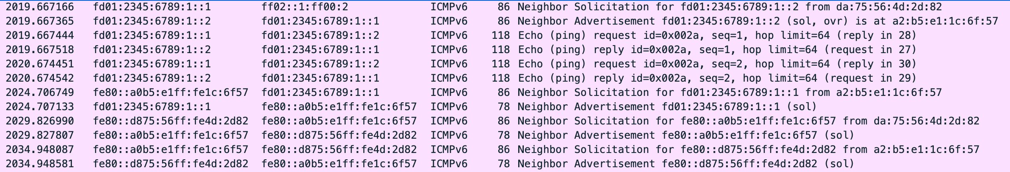
Comparing ARP to NDP
Arp and Link-Local have same process to find link address:
Arp and Global unicast have same process too to find link address, but latter
also solicits for link-local:

Slide 101
Chapter 6 LAN Switching
A note on the use of these Powerpoint slides:
We’re making these slides freely available to all (faculty, students, readers). They’re in PowerPoint form so you see the animations; and can add, modify, and delete slides (including this one) and slide content to suit your needs. They obviously represent a lot of work on our part. In return for use, we only ask the following:
If you use these slides (e.g., in a class) that you mention their source (after all, we’d like people to use our book!)
If you post any slides on a www site, that you note that they are adapted from (or perhaps identical to) our slides, and note our copyright of this material.
Thanks and enjoy! JFK/KWR
All material copyright 1996-2016
J.F Kurose and K.W. Ross, All Rights Reserved
Computer Networking: A Top Down Approach
7th edition Jim Kurose, Keith Ross Pearson/Addison Wesley April 2016

Slide 102
Link layer, LANs: outline
6.4 LAN Switches
Interconnection devices – Repeaters, Bridges¹, Routers
Bridges/LAN Switches vs. Routers
Bridges
Learning Bridges
Transparent Bridges
¹bridge: old name for switch

Slide 103
Interconnection Devices
there are many different devices for interconnecting networks.

Slide 104
Repeaters
used to extend physical layers
merely extends the baseband cable
amplifies all signals including collisions/errors – signals are attenuated as they travel along a medium and the repeater is used to extend the medium by amplifying the signal and enabling it to travel further. It is placed at a point where the signal is still considered to be strong enough

Slide 105
Bridges/LAN switches
interconnect multiple LANs, possibly different types
bridges operate at the Data Link Layer (Layer 2) and only forward link layer frames
forwarding is done based on MAC addresses and is hop-by-hop using a MAC layer forwarding table populated by the bridges themselves

Slide 106
Routers
routers operate at the Network Layer (Layer 3)
interconnect different subnetworks
use a forwarding table and IP addresses to route packets hop-by-hop

Slide 107
Switches/Bridges vs. Routers
application
transport
network
link
physical
both are store-and-forward:
routers: network-layer devices (examine network-layer headers)
switches: link-layer devices (examine link-layer headers)
datagram
frame
link
physical
frame
switch
network
link
physical
datagram
frame
application
transport
network
link
physical
datagram
frame

Slide 108
Ethernet Switch*
link-layer device: takes an active role in forwarding frames
store, forward Ethernet frames
examine incoming frame’s MAC address,
selectively forward frame to one-or-more outgoing links
when frame is to be forwarded on segment, uses Ethernet protocol to access segment
transparent
hosts are unaware of presence of switches
plug-and-play, self-learning
switches do not need to be configured, i.e., they create and manage their own forwarding tables
Henceforth we will use “switch” most of the time, but occasionally may
refer to “bridge” when discussing some aspects of the protocol

Slide 109
Switch: multiple simultaneous transmissions
hosts have dedicated, direct connection to switch
switches buffer packets
Ethernet protocol used on each link:
no collisions; one device at each end, full duplex
switching:
A-to-A’ and B-to-B’ can transmit simultaneously, without collisions
A-to-B’ and B-to-B’ can transmit simultaneously, without collisions, switch will buffer one of the frames if both arrive at the switch at the same time
A
C’
B
6
1
2
5
4
3
B’
C
A’
switch with six interfaces
(1,2,3,4,5,6)

Slide 110
Switch forwarding table
Q: how does switch know that A’ is reachable via interface 4, B’ is reachable via interface 5?
A
A: each switch has a forwarding (switch) table, each entry consist of:
MAC address of host, interface to reach host, time stamp
looks like a routing table!
C’
B
6
1
2
5
4
3
B’
C
Q: how are entries created, maintained in forwarding table?
uses a backwards learning algorithm (something like a routing protocol) to populate table with forwarding entries
A’
switch with six interfaces
(1,2,3,4,5,6)

Slide 111
Switch: self-learning
Source: A
A
Dest: A’
a switch learns which hosts can be reached through which interfaces using a process called “Backwards Learning”
when a frame is received on a link at a particular port, switch “learns” direction of sender: i.e., it can be reached via that incoming port
records sender – port pair in switch table
A A’
C’
B
6
1
2
5
4
3
B’
C
A’
MAC addr port TTL
Switch table
A
1
60

Slide 112
Switch: Forwarding
frame from source A with destination A’ arrives are switch,
enter A in forwarding table
cant find destination A’ in table, location unknown.
???
flood frame
on all outgoing ports,
BUT NOT on port frame came in on.
when/if response from A’ arrives to be forwarded to A
you add A’ to the forwarding table and you know where to find “A”
next A to A’ communication, no flooding will occur, as both hosts are now in forwarding table
Source: A
Dest: A’
C’
A
A A’
A A’
B
1
A A’
6
2
A’ A
A A’
A A’
5
3
A A’
B’
4
A A’
C
A’ A
A’
MAC addr interface TTL
A
1
60
A’
4
60

Slide 113
Summary of Frame Forwarding
assume a MAC frame arrives on port X
Is MAC address of destination in forwarding database for ports A, B, or C ?
Found?
Not found ?
Forward the frame on the stored port
Flood the frame send the frame on all ports except port X

Slide 114
Self Learning - Backwards Learning Switch in Action
forwarding table entries are set automatically with a simple heuristic:
the source address field of a frame that arrives on a port informs switch that this address (host) is reachable from this port
forwarding is based on finding the MAC destination address in the switch table. If not, flood on all outgoing ports
Port 1
x is at Port 3
Src=y, Dest=x
Src=x, Dest=y
Src=x, Dest=y
Port 4
Src=x, Dest=y
y is at Port 4
Src=x, Dest=y
Port 2
Port 5
Src=x, Dest=y
Src=x, Dest=y
Src=y, Dest=x
Src=x, Dest=y
Port 3
Port 6
Src=x, Dest=y

Slide 115
Learning Bridges Algorithm - Summary
For each frame received:
the bridge enters the source MAC address and port in forwarding table or refreshes timer of an existing entry (address seen previously and not yet expired)
the bridge looks to find entry for destination MAC address in forwarding database
if port/interface on which frame is received is same as that for destination, drop frame (e.g., broadcast environment, see next slide)
if an entry for destination MAC address exists in forwarding table, reset timer and forward the frame
if entry not found, the bridge floods all ports with the frame except for port on which the frame was received
entries are deleted when timer expires (default is 15 seconds).

Slide 116
Switch & Broadcast Environment
A
D
E
C’
B
1
2
6
3
5
4
F
C
Hub
Address | Port
D | 5
D’ | 5
A’
Broadcast
Environment
D’
switch with six interfaces
(1,2,3,4,5,6)

Slide 117
Switch: frame filtering/forwarding
when frame received at switch:
1. record incoming link port, MAC address of sending host
2. index switch table using MAC destination address
3. if entry found for destination then {
if destination on segment from which frame arrived (i.e., same segment) then drop frame
(i.e, destination and source in same direction, no need to forward, see D-D’ next slide)
else forward frame on interface indicated by entry
}
else flood /* forward on all interfaces except arriving
interface */

Slide 118

Interconnecting switches
self-learning switches can be connected together. The broadcast search still is valid.
S₄
S₁
S₃
A
S₂
D
F
I
B
C
E
G
H
Q: sending from C to I - how does S₁ know to forward frame destined to I via S₄ and S₃?
A: self learning! (works exactly the same as in single-switch case!)

Slide 119
Example
the following packets have been transmitted in the two bridge network below: (Src=A, Dest=F), (Src=C, Dest=A), (Src=E, Dest=C)
After the 3 transmissions: what have the bridges learned?
Bridge 1

Slide 120
Self-learning multi-switch example
C sends frame to I, and I responds to C
S1
Address | Port
C | 1
I | 4
1
S₄
3
S4
S₁
1
1
S₃
A
4
S₂
2
Address | Port
C | 1
I | 3
1
D
F
I
B
C
E
G
H
Q: show switch tables and packet forwarding in S₁, S₂, S₃, S₄
S3
S2
Address | Port
C | 1
I | 2
Address | Port
C | 1

Slide 121
Loops and Routing
Backwards learning
algorithm in conjunction
with flooding can cause loops
N
S₆
P
S₅
O
K
L
M
S₁
S₂
S₄
A
S₃
D
F
I
B
C
E
G
H
N

Slide 122
Danger of Loops
Consider two LANs connected by two bridges
Assume host n is transmitting a frame F with unknown destination K, i.e., no entry for K in switch tables.
What happens?
Bridges A and B flood the frame to LAN 2 and ADD LAN1 as interface for host n in switch table.
Bridge B:
sees F on LAN 2 and floods frame F on LAN 1 as it still has no destination K in its table
it also replaces entry for host n with LAN2 as interface (updates its switching table)
Bridge A does the same.
The copying/flooding continues, back and forth till a response from K arrives. If it doesn’t, no end to flooding
Where’s the problem?
Unknown destination – flooding
Bridges interconnected via loops
What’s the solution? Prevent looping
K
F
F
F
F
F
F
F

Slide 123
Spanning Tree
a solution is to prevent loops in the topology
IEEE 802.1d is a standardized algorithm that builds and maintains a spanning tree in a dynamic environment
switches exchange messages to configure the spanning tree (Configuration Bridge Protocol Data Unit - Configuration BPDU)
use flooding - takes some time to converge
one switch elected as the root
other switches choose shortest path to root
switches that run 802.1d are called transparent bridges

Slide 124
Configuration BPDUs

Slide 125
Creating a Spanning Tree with BPDUs
with the help of the BPDUs, bridges:
elect a single bridge as the root bridge.
calculate the distance of the shortest path to the root bridge
each LAN can determine a designated bridge, which is the bridge closest to the root on a shared medium (e.g., Ethernet). The designated bridge will forward packets towards the root bridge.
each bridge can determine a root port, the port that gives the best path to the root.
select ports to be included in the spanning tree (Active and Passive/Blocked).

Slide 126
Spanning Tree example
S₁ – root -> all ports are designated “d”
S₂, S₃, S₄, S₆ – designated bridges -> have a root port “r” and designated ports “d”
S₅ – blocked* -> has a blocked port “b”, has no designated ports, has a root port “r”
N
S₆
P
S₅
d
b
O
r
K
r
L
S₁
d
root
M
d
d
d
r
d
r
A
S₂
r
S₄
B
S₃
C
F
I
D
E
G
H
* Every switch has a “r” port, a switch can have 1 or more designated ports and one or more blocked ports. If it has at least one “d” port it is not a blocked switch, even though it may have 1+ blocked ports.

Slide 127
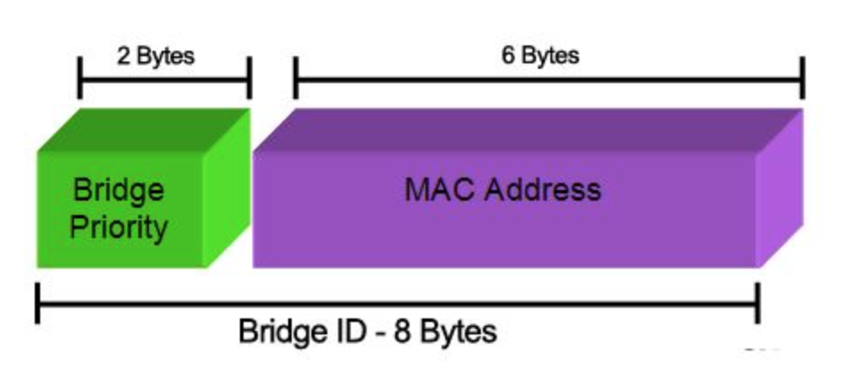
Main Concept
bridges are assigned priorities to “assist” in root election process
each switch has a unique identifier – Bridge ID:
Bridge ID = <bridge priority.MAC address>
a bridge has several MAC addresses (one for each port), picks lowest one for its ID
“bridge priority.(lowest)MAC address” is the bridge ID
each port on a bridge has a unique identifier - port ID
Root Bridge:
the bridge with the lowest Bridge ID is chosen as the root of the spanning tree
Root Port:
each bridge has a root port which points in the direction of the root
this port is identified during the spanning tree process
Bridge Priority “0”: 0.0|128.4.0.2.95.156
Bridge Priority “128.0”:128.0|128.4.0.2.95.156

Slide 128
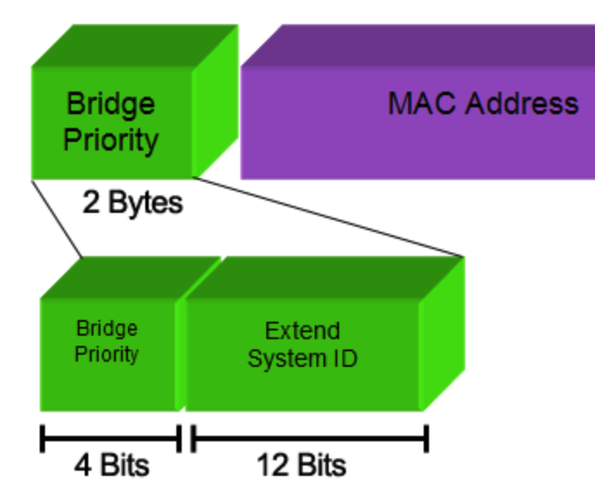
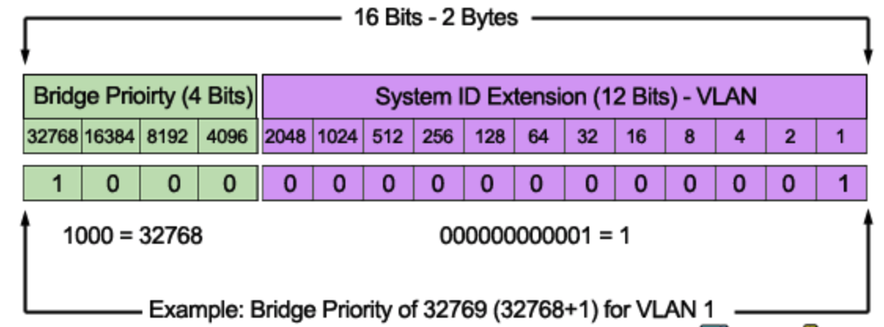
Bridge Priority and VLANs
The Bridge Priority value and the Extended System ID extension together
make up a 16 bit (2-byte) value. The Bridge Priority making up the left
most bits, is a value of 0 to 61440. The Extended System ID is a value of
1 to 4095 corresponding to the respective VLAN participating in STP.
The Bridge Priority increments in blocks of 4096 to allow the System ID
Extension to squeeze in between each increment
We should note that the Bridge Priority Field can only be set in increments
of 4096. This means that possible values are: 0, 4096, 8192, 12288, 16384,
20480, 24576, 28672, 32768 etc. By default, Cisco’s Per-VLAN Spanning-Tree
Plus (PVST+) adds this System ID Extension (sys-id-ext) to the Bridge Priority.
The two values (Bridge Priority + System ID
Extension) together make up the Bridge ID
used to elect the Root Bridge.

Slide 129
Building a Spanning Tree
Root Path Cost:
for each bridge: cost of min-cost path to the root.
usually it is measured in #hops to the root or uses standard/assigned values for link bandwidths
Designated Bridge, Designated Port:
single bridge on a LAN that provides the minimal cost path to the root bridge for this LAN:
if two bridges on a LAN have the same cost, one with lowest bridge ID is selected
if the min-cost bridge has two or more ports on the LAN, select port with lowest port ID

Slide 130
Steps of Spanning Tree Algorithm
1. Determine the root bridge
2. Determine the root port on all other bridges
3. Determine the designated port on each LAN
Each bridge sends out BPDUs that contain the following information:
root ID
cost
bridge ID/port ID
root bridge (what the sender thinks it is) root path cost for sending bridge Identifies sending bridge

Slide 131
Ordering of Messages
We can order BPDU messages with the following ordering relation “<<“:
If (R1<R2) e.g.: R1=5, R2=8
M1<< M2 → propagate BPDU with lowest root Bridge ID - R1
elseif ((R1==R2) & (C1<C2)) e.g., R1=R2=5, but C1=2, C2=3
M1 << M2 → propagate BPDU with lowest cost path to root – C1
elseif ((R1==R2) & (C1==C2) & (B1<B2)) e.g., R1=R2=5, C1=C2=2, B1=4, B2=12
M1 << M2 → propagate BPDU with lowest originating Bridge ID - B1
If above holds, M1 is dominant and M2 will change its information to match M1
Else M2 is dominant and M1 changes to follow M2
M1
ID R1
C1
ID B1
<
ID R2
C2
ID B2
M2

Slide 132
Step 1: Determine the Root Bridge
initially each bridge assumes it is the root bridge.
each bridge B broadcasts a BPDU of this form on all its ports:
M=
each bridge examines all the BPDUs it receives on all of its ports and compares to its own transmitted BPDU. (is my M << received M?)
root bridge, at any point in time, is the smallest received root ID that has been received so far
whenever a M with a lower value for root bridge ID arrives, the root bridge field is up dated and the bridge sends out a BPDU with the new root bridge ID
otherwise bridge maintains the current value
B
0
B

Slide 133
Step 2: Calculate the Root Path Cost - Determine the Root Port
for a bridge B
determine the min Root Path Cost (Cost) to root R as follows:
if B = R : Cost = 0 (i.e., it is the root)
if B ≠ R: Cost = {Lowest Cost in a received BPDU, e.g., on port A, with R as root} + 1
B’s root port is the port from which B received the lowest cost path to R (in terms of relation “<<‘’). E.g., port A
B’s new/current BPDU is now:
every time B receives on port X “better news”, i.e., better (<<) Root, or Cost or B(ridge) ID, it updates its BPDU
transmits its updated BPDU on all outgoing ports except on port X
port X is now the root port
R
Cost
B
A

Slide 134
Updating and Sharing Information
bridge B’s current state:
bridge B will only send its current BPDU to a neighbor if it receives “worse news” on any of its ports from that neighbor
it updates its BPDU it if receives “better news” from a neighbor on one of its ports (that port now becomes the new root port) and broadcasts an updated “updated” BPDU on all its non root ports.
R
Cost
B
A
Worse news
Current BPDU
BRIDGE
Updated BPDU
BRIDGE
Better news
Update BPDU

Slide 135
In Summary
a bridge B generates an updated BPDU because it received better news on a port, e.g., port X.
the updated BPDU is now its current BPDU
B will then share this updated information on all its “other” (A, B, C) ports
B also concludes that it is now the designated bridge for the LANs connected to its other ports, (unless it hears better news from a bridge via one of those ports in response to its updated BPDU)
Root
Cost
B ID
X
A

Slide 136
Example of Updating and Sharing
bridge B (ID 8) receives on port “X” the following BPDU from a neighboring bridge (ID 12):
and B’s current BPDU is:
because Cost 2 << Cost 3 (worse news), B will broadcast on its port “X” its current BPDU to let bridge (ID 12) know it has a shorter path to the root bridge (ID 2) via port A (its current root port)
bridge with ID 12 then has to decide whether to use bridge B (cost = 2+1 = 3) for its path to the root or stick to its current choice = 3 too. What will bridge ID 12 do? It will use the Bridge IDs to break the tie (Bridge B=8 vs ?)!
if INSTEAD B’s current BPDU is:
Cost 5 >> then Cost 3 (better news)
B will broadcast on all its other ports (A,B,C) an updated BPDU:
where “4” (3+1) is new cost from Bridge B on port X to root bridge (ID 2) (via bridge ID 12).
port X is now its root port
R=2
Cost=3
12
C
R=2
Cost=2
8
A
2
5
8
A
2
3+1=4
8
X

Slide 137
Animating the previous example
F
X
A
BRIDGE12
BRIDGE8
B
R=2
Cost=3
12
C
C
R=2
Cost=2
8
A
Bridge8 BPDU is << Received BPDU from Bridge12 via port X
Bridge8 claims it has better INFO (news) (C₈=2 < C₁₂=3), i.e., received news is worse
Bridge8 sends its BPDU to neighboring Bridge12 via Port X
X
F
BRIDGE8
BRIDGE12
R=2
Cost=3
12
C
R=2
Cost=2
8
A
BRIDGE??
Q: What will Bridge12 do? Cost 2+1=3.
Its current BPDU came via port C from Bridge??
A: Compare current BPDU to received BPDU
R=2
Cost=3
12
F
If ?? > 8 ? e.g. (?? = 20)
Changes its choice to Bridge8 to connect to Root via “F”
If ?? < 8 ? e.g. (?? = 4)
Retains its current choice of Bridge?? to connect to Root via “C”
R=2
Cost=3
12
C
C

Slide 138
Animating the previous example
F
X
A
BRIDGE12
BRIDGE8
B
R=2
Cost=3
12
C
C
R=2
Cost=5
8
A
Bridge8 BPDU is >> Received BPDU from Bridge12 via port X
Bridge8 claims it received better news (C₈=5 >> C₁₂=3)
Bridge8 UPDATES its BPDU -> C = 3 + 1 = 4, and Root Port now is “X”
Bridge8 sends its UPDATED BPDU to its neighbors on ports A,B,C
Ports A, B, C
BRIDGE8
R=2
Cost=4
8
X

Slide 139
Selecting the Ports for the Spanning Tree
Now that Bridge B has figured out the root bridge, the root path cost, and the designated bridge and port for each LAN:
B can decide which ports are in the spanning tree:
B’s root port is part of the spanning tree (every bridge has to have a root port)
The ports on all the LANs for which B is the designated bridge are part of the spanning tree (designated ports).
B’s ports that are in the spanning tree will forward packets (=forwarding state)
B’s ports that are not in the spanning tree will not forward packets (=blocking state)
it is possible that a bridge may not be the designated bridge on any LAN (have no designated ports)
all its ports other than the root port are blocked -> blocked bridge

Slide 140
Spanning Tree example – what is the spanning tree?
consider the network on the right.
assume that the bridges have calculated the designated ports (D), the blocked ports (B) and the root ports (R) as indicated.
what is the spanning tree?
B
2
3
1
B
4
5

Slide 141
Block Diagram of Spanning Tree
D
B2
D
Root
B
LAN2
D
2
3
LAN5
R
R
1
B1
R
B4
B
Blocked
Designated
4
B3
B
Blocked
D
LAN1
B
R
5
B5
Designated
D
D
LAN4
LAN3

Slide 142
Routes to and from PCs
PC1
PC1 - 3
3
PC3 - 4
B
B2
4
2
3
LAN2
PC1
1
LAN5
B
1
4
B1
B4
PC1 - 2
B3
PC3 - 1
PC2
2
PC2
5
LAN1
PC1 ping PC3?
PC2 ping PC1?
Path of ARP, ICMP
Bridge Tables
1
B5
PC1 - 1
PC3
PC3 - 2
2
LAN4
LAN3
PC3

Slide 143
Spanning Tree example
Assume S₂ ID < S₆ ID
N
S₆
P
S₅
d
b
?
O
r
K
S₁ is
root
r
S₁
d
L
?
d
d
M
d
d
r
r
r
A
G
C
I
B
D
F
H
S₂
E
S₄
S₃

Slide 144
Health of the Spanning Tree
consider the network on the right - if link between S₅ and S₂ goes down or S₂ fails -> tree is damaged
S₅ is now isolated and cannot send to, or receive traffic from, the rest of the tree
using “hello” messages, the switches will notice the failure of a component and re-calculate the spanning tree
S₆
N
d
P
S₅
b
O
r
S₁
K
r
d
root
L
X
d
d
M
d
d
r
r
r
A
F
B
C
D
I
E
G
H
S₂
S₃
S₄

Slide 145

Detecting and Recovering from Failures
hello messages are generated periodically by the root switch, which sends them out on each link to the next level of switches
every switch that receives a hello message, replaces the bridge ID with its own, and passes it on to the next level of switches (using designated port)
all switches receive the hello messages on their root ports, and forward them via their designated ports
if a switch does not receive a hello message within a certain period of time (fixed interval), it starts a “recovery” timer that is 3x the hello message interval
if that timer expires, it will assume the tree is broken and deletes all port designations
it then initiates the spanning tree algorithm by sending out a BPDU declaring itself as Root.
S₆
N
d
P
S₅
S₅
0
S₅
r
b
“hello”
O
S₁
K
r
“hello”
root
d
root
L
S₅
X
d
d
0
S₅
“hello”
r
M
“hello”
d
d
r
“hello”
r
“hello”
A
F
B
C
D
I
E
G
H
S₂
S₃
S₄
S₅
0
S₅

Slide 146
Summary: switches vs. routers
both are store-and-forward:
routers: network-layer devices (examine network-layer headers)
switches: link-layer devices (examine link-layer headers)
both have forwarding tables:
routers: compute tables using routing algorithms, IP addresses
switches: learn forwarding table using flooding, learning, MAC addresses
application
transport
network
link
physical
datagram
frame
link
physical
frame
switch
network
link
physical
datagram
frame
application
transport
network
link
physical

Slide 147
Headers & Addresses
source
message
M
application
transport
network
link
physical
segment
H_{t}
M
H_{t}
datagram
H_{n}
H_{t}
M
frame 1
H_{l}
H_{n}
H_{t}
T_{l}
M
frame 1
link
physical
H_{l}
H_{n}
H_{t}
T_{l}
M
H_{x}: header
T_{x}: trailer
M: message
X: t - transport, n - network, l - link
switch
frame 1
H_{l}
H_{n}
H_{t}
T_{l}
M
destination
H_{n}
H_{t}
M
network
link
physical
frame 2
application
transport
network
link
physical
H_{l}
H_{n}
H_{t}
T_{l}
M
M
H_{t}
M
H_{n}
H_{t}
M
=
H_{n}
H_{t}
M
router
frame 2
H_{l}
H_{n}
H_{t}
T_{l}
M
frame 1
H_{l}
H_{n}
H_{t}
T_{l}
M

